Slide 1

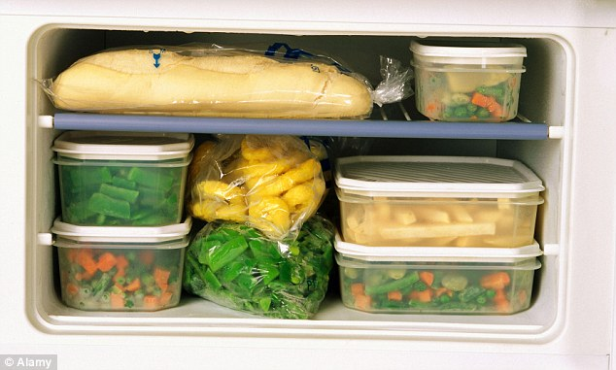
Grow limitless
or
Store for the future!!
Notes:
I was told that we are having a very informal session here, and so as the title!!
Now should we enjoy all our available foods and grow as far as we can
Or should we save a bit for upcoming days
Now the question is if we do store, then how much and when should we store??
Ok now come to the point and think from plants perspective: whether they grow limitless or store a bit of carbon for the future

Slide 2
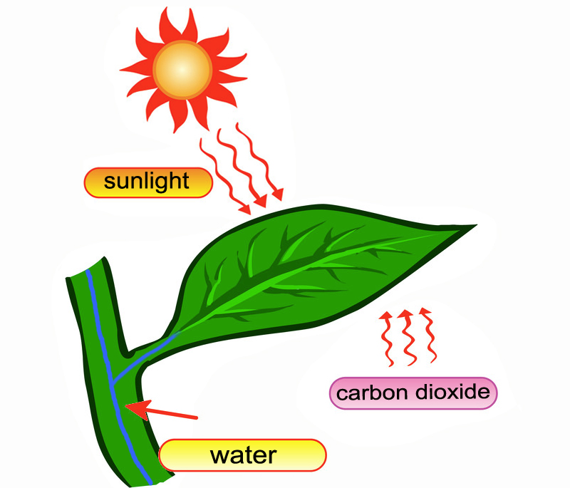


The concept
Bradford & Hsiao 1982, McDonald 1986, Gifford 1987, Poorter et al. 1990
GPP
Growth
Storage
How plants will respond to environmental stress
Notes:
Lets start with the basic concept of GPP and plant growth
As photosynthesis provides the main substrate for plant growth, so studies of growth responses to environmental stress often focus on photosynthetic responses.
While these two responses can be closely correlated, it has long been observed that increased photosynthesis does not necessarily lead to increased growth (e.g. Bradford & Hsiao 1982, McDonald 1986, Gifford 1987, Poorter et al. 1990).
So where does the leftover photosynthate go then??
Is that lost to environment? Or plants may store them for future stress.
The big question is how much is storing in this box, when and why it happens: is this accumulation simply a passive consequence of stress-induced growth limitation (Chapin et al. 1990; Pereira 1995), or is it an active ‘hedge-betting’ strategy for saving resources in anticipation of future stress?
So we are looking for answers to these questions through our modeling effort.
These are important to answer because it directly affects our ability to predict how plants will respond to extreme environmental stress such as severe drought, fire etc.

Slide 3
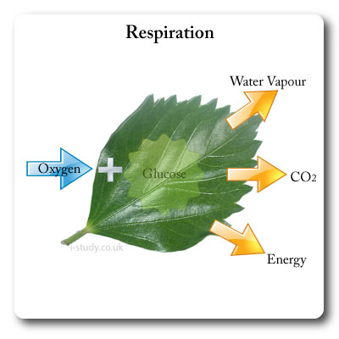

The concept
GPP
Respiration
Storage
NPP
Notes:
So here is the typical carbon flow chart.
And what we are suggesting is inserting an extra box of storage in this Carbon flow diagram to see how much is stored and when??
A lack of both empirical data and theoretical understanding currently hampers the ability to quantify this storage box.
So we are trying to address both the gaps to infer empirical growth-storage patterns using novel data assimilation technique applied to results from an experiment on Australian woody species.

Slide 4
Data Assimilation (DA)
Conceptual DA model framework
Systematic combination of observation with the model to better estimate system dynamics
Finds the model representation that is most consistent with observations
Propagates forward information from previous observations
Predictions of the model are then corrected comparing with the observations
Poor model vs. effective model
Must conserve the information provided by the model itself and by previous observations
Input
Output
Measurements
State variables
Parameters
Predictions
Updated state variables
Model
Data Assimilation
MCMC, KF, 3D-Var, 4D-Var…
The simplest and easier to computationally implement
MCMC has become a universal algorithm
It may require more model evaluations and computational time
Notes:
Now lets talk about the technique
Here is the conceptual model framework for data assimilation where Model is the center piece.
And then all models require inputs, including measurements of driver variables, estimates of state variables, and parameters which govern how model processes respond to driver variables.
Data assimilation is the systematic combination of measurements with the model to better estimate system dynamics, i.e. estimate parameters and forecast state variables.
DA is the process of finding the model representation that is most consistent with observations.
The model organizes and propagates forward information from previous observations.
When new information becomes available, the predictions of the model are then corrected comparing with the observations.
If we setup a poor model then that will drift and will be frequently and heavily corrected, on the other hand, an effective model will require little correction by observations.
However, it is not simply a question of fitting the model to the new data, as the assimilation process must also conserve the information provided by the model itself and by previous observations.
A significant advantage of the DA framework is that it quantifies uncertainty around the estimates in addition to giving best values (Williams et al. 2005).
There are numerous DA techniques available like MCMC, Kelman Filtering, 3D-Var, 4D-Var etc.
We have chosen the general Marcov chain Monte Carlo method.
This is the simplest one from all available algorithms and are easier to computationally implement.
Because of the applicability of MCMC across the biological, mathematical, and physical sciences and its rich history, MCMC has become a universal algorithm (Richey 2010).
The disadvantage is that it may require more model evaluations and computational time as this algorithm considers all of the data for every iteration.
However, in our case we have reasonably a small model with 4 months of daily data and only five parameters to quantify, so the computational time isn't a factor in this case.

Slide 5
MCMC
The Metropolis algorithm
What we need:
(1) A model: M
(2) Data: D
(3) A prior probability distribution for the parameters: P(θ)
(4) A likelihood function: P(D|θ) which is a function of the difference M(θ)-D
x_{i} represents the ith of N measurements
η_{i} is the model-derived estimate of a measurement
σ represents the uncertainty of the data about the model
The ‘Π’ symbol denotes the product of all measurements
Zobitz et al. (2011)
Notes:
The Metropolis algorithm is the simplest form of MCMC algorithm.
A brief summary of the Metropolis algorithm is provided here.
The Metropolis algorithm:
What we need are: (1) A model: M
(2) Data: D
(3) A prior probability distribution for the parameters: P(θ)
(4) A likelihood function: P(D|θ) which is a function of the difference between the modeled values and the data
The likelihood function we use here is the general one.
Ant the notations are here.
x_{i} represents the ith of N measurements
η_{i} is the model-derived estimate of a measurement
σ represents the uncertainty of the data about the model
The ‘Π’ symbol denotes the product of all measurements, generated from assuming that all our measurements are independent
This likelihood function assumes that all errors are normally distributed and that the standard deviation σ follows a uniform distribution
In practice, to avoid issues with numerical precision and to increase computation speed, this Eq. is written as a sum function by taking the natural logarithm of both sides and using standard logarithm algebraic identities
Then the cost function is interpreted in terms of ‘‘log likelihood’’ or LL

Slide 6
MCMC
The Metropolis algorithm
What we do:
(1) Select any starting point in parameter space, θ⁽⁰⁾
(2) Calculate the product of prior and likelihood: π⁽⁰⁾=P(θ⁽⁰⁾)•P(D|θ⁽⁰⁾)
(3) Set i=0
(4) Run the following loop until we have enough sample points:
(i) Generate a random new point, θ^{(candidate)}
(ii) Calculate π^{(candidate)} = P(θ^{(candidate)})•P(D|θ^{(candidate)})
(iii) Calculate the Metropolis ratio: π^{(candidate)} / π^{(i)}
(iv) Accept the candidate with probability equal to min(Metropolis ratio,1)
(v) If the candidate is accepted: θ^{(i+1)} = θ^{(candidate)}, else: θ^{(i+1)} = θ^{(i)}
(vi) Set i=i+1
What we get:
A representative sample {θ⁽⁰⁾ …θ^{(n)}} from the posterior pdf, P(θ|D)
Discard an initial part of the MC for Burn-in process
Notes:
What we do are: Select any starting point in parameter space, θ(0)
Then we calculate the product of prior and likelihood: π(0)=P(θ(0))•P(D|θ(0))
We then set i=0 and run a loop until we have enough sample points
Generate a random new point by walk through the parameter space
The candidate parameter vector is generated by taking a multivariate normal step away from the current vector.
Similarly calculate the product of prior and likelihood for this new candidate
Calculate the Metropolis ratio with the products
Accept the candidate with probability equal to min(Metropolis ratio,1)
If the candidate is accepted, we consider the new candidate as a modeled parameter, otherwise we stick to the previous candidate
So finally what we get is ‘n’ number of representative samples from the posterior pdf
At the end we discard an initial part of the MC (few iterations) for Burn-in process from the total chain length

Slide 7
The Model
a_{f}
s_{f}
Input
Output
R_{a}
R_{a}
R_{a}
C_{f}
R_{a}
R_{growth}
R_{growth}
Measurements
State variables
Parameters
Predictions
Updated state variables
Y
Y
R_{h}
Model
s_{f}
s_{f}
a_{f}
s_{f}
a_{f}
a_{f}
C_{f}
C_{f}
a_{r}
k
s_{r}
C_{f}
C_{lit}
k
GPP
GPP
GPP
C_{r}
C_{lit}
GPP
C_{storage}
C_{storage}
R_{h}
Data Assimilation
1-Y
1-Y
a_{r}
a_{r}
a_{r}
s_{r}
s_{r}
C_{r}
C_{r}
C_{r}
C_{lit}
C_{lit}
a_{s}
C_{s}
C_{SOM/CWD}
a_{s}
a_{s}
a_{s}
C_{s}
C_{SOM/CWD}
C_{s}
C_{s}
Williams et al. 2005, Bloom &
Williams 2014, Bloom et al. 2016
Notes:
Now looking at the DA framework, the backbone of it is “The Model”
So let’s talk about the typical model that has been used for a decade by various researchers to analyze forest carbon dynamics using data assimilation.
This sort of dynamic model can combine both stock and flux observations together to provide improved estimates of ecosystem carbon exchange.
Now what we are suggesting to improve this model is to push the whole biomass allocation thing aside to make room for an additional box, that we call storage pool.
We then add a flux parameter Utilization coefficient (k) to control the flow of carbon from the storage pool to the biomass allocation.
So this is a simple modification with the existing model, however we believe this is a significant alteration with this coefficient can quantify the amount of storage for future stress and the actual amount of carbon utilizing for immediate growth.
Nonetheless, we consider the carbon loss due to growth respiration with a rate Y and the rest (1-Y) goes to biomass allocation.
Then for simplicity we remove the soil portion
We also assume there is no turnover for either stem and root as the seedlings in our experiment are young enough (only 20 weeks old) not to lose any stem and root

Slide 8
Model Equations
C_{storage}[i] = C_{storage}[i-1] + GPP[i-1] - R_{d}[i-1] * (M_{leaf}[i-1] + M_{root}[i-1] + M_{stem}[i-1])
- k[i-1] * C_{storage}[i-1]
S_{leaf}[i] = C_{storage}[i] * 0.75
S_{stem}[i] = C_{storage}[i] * 0.16
S_{root}[i] = C_{storage}[i] * 0.09
From Duan's experiment:
75% of total storage goes to leaf
16% of total storage goes to stem
9% of total storage goes to root
C_{leaf}[i] = C_{leaf}[i-1] + k[i-1] * C_{storage}[i-1] * a_{f}[i-1] * (1-Y) - s_{f}[i-1] * C_{leaf}[i-1]
C_{stem}[i] = C_{stem}[i-1] + k[i-1] * C_{storage}[i-1] * a_{s}[i-1] * (1-Y)
C_{root}[i] = C_{root}[i-1] + k[i-1] * C_{storage}[i-1] * (1-a_{f}[i-1]-a_{s}[i-1]) * (1-Y)
M_{leaf}[i] = C_{leaf}[i] + S_{leaf}[i]
M_{stem}[i] = C_{stem}[i] + S_{stem}[i]
M_{root}[i] = C_{root}[i] + S_{root}[i]
Notes:
Here are the Model equations which are based on carbon mass balance.
The notations we have used are: M = for total carbon mass (gC); S = for total storage carbon (gC); C = for total Carbon for growth (gC), so M is the sum of C and S.
So starting with the storage pool, storage at time i would be the sum of previous storage plus GPP coming in minus respiration going out minus storage utilized for biomass growth.
Now the storage box which is the sum of three storage in different plant organs (leaf, stem and root).
For storage partitioning we use the data from Duan’s draught induced mortality Experiment on Eucalyptus radiata seedlings.
From that experiment we get the whole plant as well as different organs’ TNC concentrations which give us the portion of storage in different organ of leaf, stem and root.
After analysing his data we find 75% of total storage goes to leaf, 16% to stem and 9% to root.
Now the equations for carbon utilized for biomass growth of leaf, stem and root.
Leaf carbon stock at any time would the the sum of previous stem leaf carbon plus the carbon coming down from GPP minus the leaf turnover.
Similar calculation for stem and root, however we assume there is no turnover for either stem and root as these are small seedlings of only 20 weeks old.
Finally the total carbon mass will be the sum of storage carbon and growth carbon.

Slide 9
Data
Court’s experiment
Daily GPP:
R_{a}
R_{growth}
Y
k
a_{f}
s_{f}
✔
C_{f}
C_{lit}
GPP
C_{storage}
Cday(t) = modelled daily gross C gain using coupled photosynthesis - stomatal conductance model and fitting with the 'plantecophys' package
1-Y
a_{r}
C_{r}
σ_{s} = self shading factor which is a linear function of LA
a_{s}
C_{s}
✔
Input
Output
b and i (intercept) were calculated using ‘YplantQMC’ package for individual treatment
Measurements
State variables
Parameters
Predictions
Updated state variables
Model
Data Assimilation
Notes:
We have already setup the model, now let’s think about the left box, that is “Inputs” combining data measurements, state variables and parameters
We are very much thankful to Court who’s enormous effort makes the starting point of this project, and that’s the data set I’m talking about.
He did the belowground sink limitation experiment with 49 20 weeks old Eucalyptus tereticornis seedlings those were planted in six container volumes ranging from 5 L to 35 Lin addition to free seedlings and monitored for 4 months from 21st Jan 2013 to 21st May 2013.
So each experimental block (n=7) contained a complete replicate set of six container volumes as well as one Free seedling.
He made a whole set of measurements and among those I will briefly talk about the ones that we use to verify our DA framework.
Now looking at the model I would start from the main box of GPP.
So we estimate total photosynthetic carbon gain (GPP) using the Leaf gas exchange and Photosynthetic CO2 response (ACi) curve measurements.
The daily GPP is calculated by the multiplication of modelled daily gross C gain and a self shading factor.
Cday(t) is quantified using the biochemical (coupled photosynthesis - stomatal conductance) model of Farquhar et al. (1980) and fitting with the 'plantecophys' package of Remko with the mean photosynthetic parameters (Jmax, Vcmax, Rdark and g1) and those are obtained from the ACi curves.
Then the self shading factor σ_{s} which is a linear function of LA where ‘b’ and ‘intercept’ were calculated from ‘YplantQMC’ package of Remko for individual treatment.
This σ_{s} is accomplished by utilizing 61 previously digitized Eucalyptus seedlings, covering 5 total species including E. Tereticornis.
So lets put a tick on this box.

Slide 10
Data
Daily Respiration:
✔
R_{a}
R_{growth}
Y
k
a_{f}
s_{f}
C_{f}
C_{lit}
GPP
C_{storage}
✔
1-Y
a_{r}
Measurements for R(12.3) were taken for various treatments at 12.3⁰C
Q₁₀ = 1.86
Temperature data for 15 mins interval
SLA from Leaf gas exchange
C_{r}
a_{s}
C_{s}
Notes:
Now come to the next point once we have the tick on the GPP box.
Daily leaf respiration and thanks to Court again who did the hard job for us to calculate this.
Leaf dark respiration rates were measured on each seedling using Licor instrument and standardized at 25°C using a Q10 value of 1.86, developed for these seedlings in a separate experiment performed by John Drake.
Met data is used for 15 mins temperature measurements and Specific leaf area (SLA) in calculated from the leaf area and leaf mass at that time from leaf gas exchange.
We then sum up and average all 15 mins respiration rates for the whole day to get the daily data.
So now we can put another tick beside R_{a}.

Slide 11
Data
Leaf TNC concentration measurements during leaf gas exchange
Average TNC on six occasions and the uncertainty bound from all replicates
✔
R_{a}
R_{growth}
Y
✔
k
a_{f}
s_{f}
C_{f}
C_{lit}
GPP
C_{storage}
✔
1-Y
a_{r}
C_{r}
✔
S_{stem}
S_{leaf}
S_{root}
a_{s}
C_{s}
C_{storage}
Notes:
Now move to the next box of storage which is actually the sum of all storage pools in leaf, stem and root.
Among these the major portion comes from Leaf total non-structural carbohydrate (TNC) (starch and soluble sugar concentrations), and we measured these during 6 leaf gas exchange measurements for all replicates and treatments.
So we have the average TNC on 6 occasions and the uncertainty (standard error) bound from all 6 replicates.

Slide 12
Data
Leaf mass: Initial (t=1) and harvest (t=T)
Estimate weekly leaf carbon stock
✔
R_{a}
R_{growth}
Y
✔
✔
k
a_{f}
s_{f}
C_{f}
C_{lit}
GPP
C_{storage}
✔
Root mass: Initial (t=1) and harvest (t=T)
✔
1-Y
a_{r}
C_{r}
Stem mass: Initial (t=1) and harvest (t=T)
✔
✔
S_{stem}
S_{leaf}
S_{root}
a_{s}
C_{s}
Estimate weekly stem carbon pool from weekly stem height and diameter (at 15 cm)
Calculate the data uncertainty for all these carbon pools from 6 replicates
C_{storage}
Notes:
Then forward to all three boxes of biomass stocks of leaf, stem and root.
We have initial and harvested dry mass of leaves, the initial data were collected from 10 similar harvested seedlings and harvested data from all 7 replicates.
Starting from the foliage pool, we have weekly measurement of Leaf counts for the whole duration of experiment and using this and the harvested leaf mass we estimate the weekly leaf carbon stock.
For the root mass we have only the initial and harvest data.
For the stem mass we have similar initial and harvest data.
Moreover, we have weekly measurements of stem height and diameter at 15 cm, that we have used to model weekly stem carbon pool fitting a linear regression model.
We fit the model with 10 initial data and 7 harvested data of free seedlings.
Then we estimate weekly stem mass from this fitted linear regression equation using weekly stem height and diameter (at 15 cm) for all treatments.
At the end, we calculate the data uncertainty for all these carbon pools from 6 replicates we have.

Slide 13
Novelty
One pseudopool??
GPP calculates using a simple canopy-scale model
Autotrophic respiration is a fixed fraction of total photosynthetic fixation
Fluxes are constant fraction of their donor pools
R_{a}
a_{f}
C_{f}
s_{f}
R_{h}
GPP
a_{r}
C_{r}
s_{r}
C_{lit}
a_{s}
C_{s}
C_{SOM/CWD}
VS
R_{a}
R_{growth}
Genuine pool
GPP calculates based on leaf gas exchange and ACi curve measurements
Leaf dark respiration rates (R) were measured using Licor 6400
Time-varying rate constants for the fluxes
Y
k
a_{f}
C_{f}
s_{f}
C_{lit}
GPP
C_{storage}
1-Y
a_{r}
C_{r}
a_{s}
C_{s}
Notes:
As I have already discussed about the model and data we use in this project, this is the time to summarize the difference between the previous model and the model we used.
This will establish the novelty of the work as well.
The most vital addition is the storage pool where in previous models there is one pseudopool that the daily accumulation of photosynthate (GPP) is entirely utilized each day.
So we add a genuine pool called storage pool that can control the carbon flow towards tree growth.
Currently, the model estimates total photosynthetic carbon gain using a simple canopy-scale model (ACM, Aggregated Canopy Model) that assumes a horizontally homogeneous canopy.
We replace this model with Leaf gas exchange and Photosynthetic CO2 response (ACi) curves measurement.
Previous model assumes that photosynthetic rates are fixed, and that there is a fixed fraction of total photosynthesis used in respiration.
Leaf dark respiration rates (R) were measured on each seedling using Licor 6400.
Last but not least, another significant addition is allowing time-varying rate constants for the fluxes.
Currently the fluxes among pools are estimated as a constant fraction of their donor pools.
We estimate how fluxes vary among time-steps and this is done using the DA method.

Slide 14
Novelty
R_{a}
a_{f}
C_{f}
s_{f}
R_{a}
R_{h}
Y
R_{growth}
VS
GPP
a_{r}
C_{r}
s_{r}
C_{lit}
k
a_{f}
C_{f}
s_{f}
C_{lit}
GPP
C_{storage}
a_{s}
C_{s}
C_{SOM/CWD}
1-Y
a_{r}
C_{r}
a_{s}
C_{s}
Invaluable tool for quantifying carbon fluxes as well as infer the rate and timing of the transfer of photosynthate to and from storage
Estimate the likelihood of alternative hypotheses explaining all these carbon fluxes
Belowground sink limitation affects both rates of photosynthesis and the fate of C allocation to growth, respiration and storage
Theoretical understanding of predictive models for growth vs. storage dynamics under alternative allocation hypotheses
Notes:
With these modifications in place, we believe that the DA framework becomes an invaluable tool for quantifying carbon fluxes in experimental systems, enabling us to extract significant new information from existing datasets for example the rate and timing of the transfer of photosynthate to and from storage.
We could estimate the likelihood of alternative hypotheses explaining these fluxes.
Modeling cumulative net seedling C gain suggests that all the components of the C balance including photosynthesis are required to explain the observed seedling biomass response to sink manipulation.
This modeling study focuses on that how belowground sink activity affects both rates of photosynthesis and the fate of C allocation to growth, respiration and storage.
All these will definitely boost the theoretical understanding of predictive models for growth vs. storage dynamics under alternative allocation hypotheses

Slide 15
Parameters
Utilization coefficient (k)
Growth respiration coefficient (Y)
Foliage allocation fraction (a_{f})
Root allocation fraction (a_{r})
Stem allocation fraction (a_{s})
Foliage turnover rate (s_{f})
R_{a}
R_{growth}
Y
k
a_{f}
s_{f}
C_{f}
C_{lit}
GPP
C_{storage}
1-Y
a_{r}
C_{r}
a_{s}
✔
C_{s}
✔
Input
Output
Measurements
State variables
Parameters
Predictions
Updated state variables
Model
Data Assimilation
Notes:
Finally the parameters that we need to infer are:
Utilization coefficient (k) that actually quantifies the fraction of photosynthates that plants keep in reserve as insurance against future stress, and what fraction do they use for immediate growth.
Growth respiration coefficient (Y) defines the carbon loss due to growth respiration.
Foliage, root and stem allocation fractions which distribute the carbon as required for different organs of seedlings.
Lastly the Foliage turnover rate (s_{f}) determines the amount of leaf litter fall.

Slide 16
Initial Parameter settings
Parameter | Minimum | Maximum | Starting value
k | 0 | 1 | 0.45
Y | 0.25 | 0.35 | 0.3
a_{f} | 0.1 | 0.7 | 0.4
a_{s} | 0.1 | 0.6 | 0.25
s_{f} | 0 | 0.1 | 0.05
a_{r} = 1 - (a_{f} + a_{s}), check on 0 < a_{r} < 1.0
Notes:
To start DA we need to first initialize the parameter space from where the MCMC algorithm generates candidate parameter vectors.
So we define a parameter space with lower and upper bounds of the prior parameter pdf and the starting point of the chain.
This table shows the values.

Slide 17
Initial carbon pools
Initial measurements:
GPP[t=1]
R_{d}[t=1]
C_{f}[t=1]
C_{r}[t=1]
C_{s}[t=1]
C_{storage}[t=1]
R_{a}
R_{growth}
Y
a_{f}
s_{f}
k
C_{f}
C_{lit}
GPP
C_{storage}
1-Y
a_{r}
C_{r}
a_{s}
C_{s}
From Duan's experiment:
S_{leaf}/M_{leaf} = 0.1401421
S_{stem}/M_{stem} = 0.0453869
S_{root}/M_{root} = 0.02154037
Notes:
So we setup the model and preprocess the inputs required for DA, now come to the main point of analyzing the data and infer the parameter set from DA
To start DA we need to further initialize the carbon pools at time=0.
For the initial carbon pools, we have modeled daily GPP and Rd data for the whole duration of the experiment.
We also have initial dry mass of leaves, stems and roots, collected from 10 similar harvested seedlings at the beginning of the experiment.
From Duan's experiment for TNC partitioning to tree organs, we calculate the ratio of Leaf, stem and root TNC to their dry masses.
And here are the numbers.
So we figure out the storage pools in all these organs from the initial biomasses and sum up to get the total C_{storage} at the beginning.

Slide 18
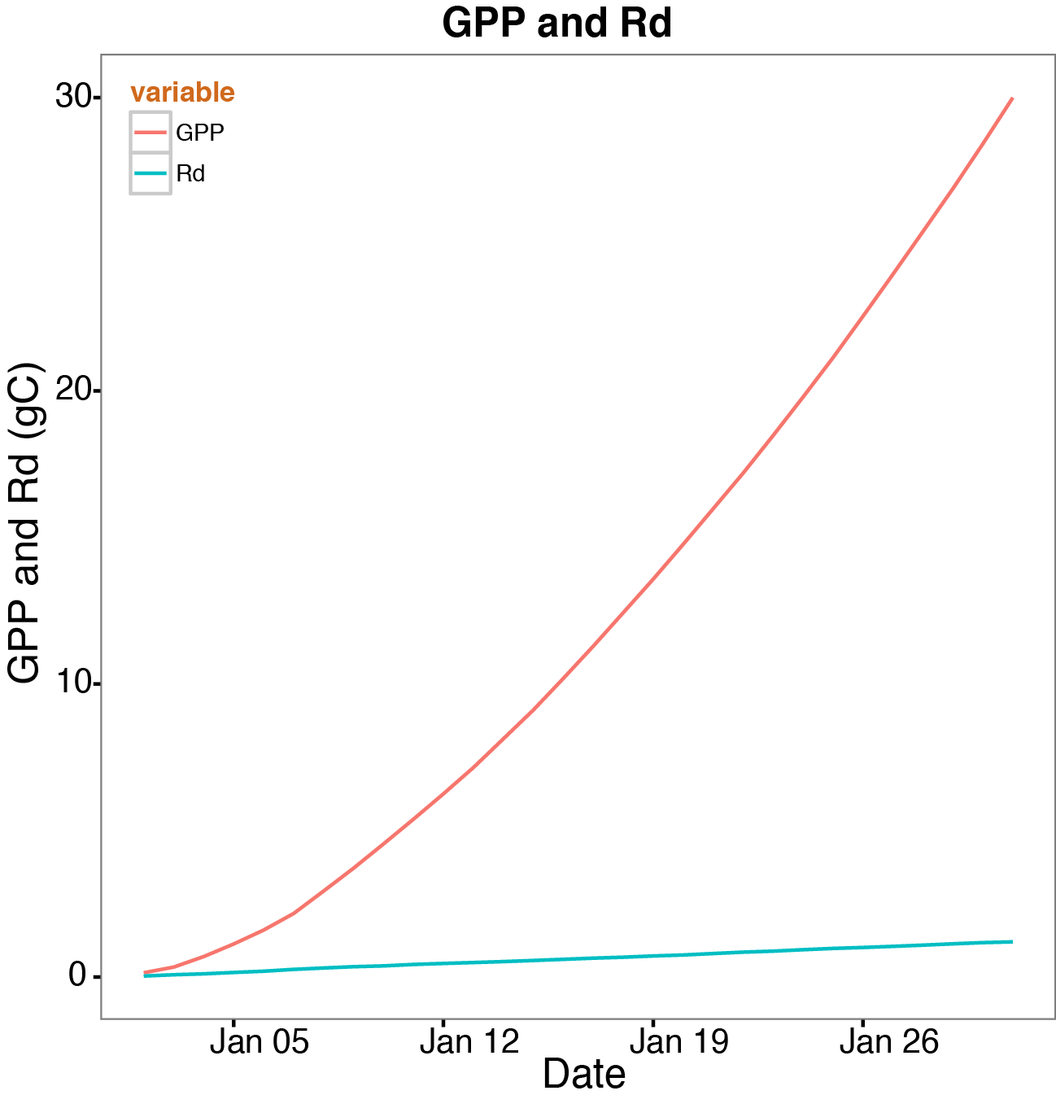
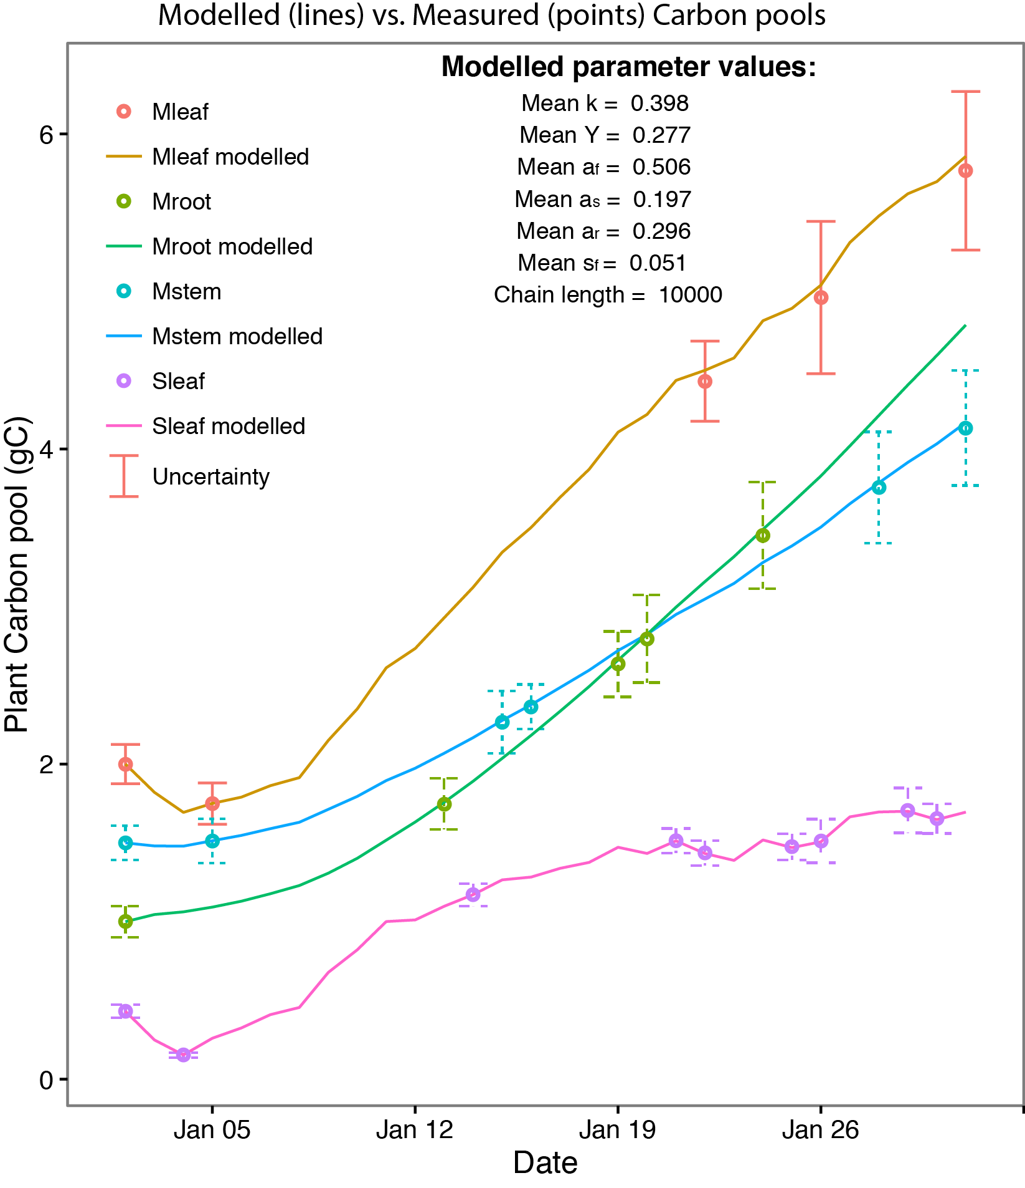
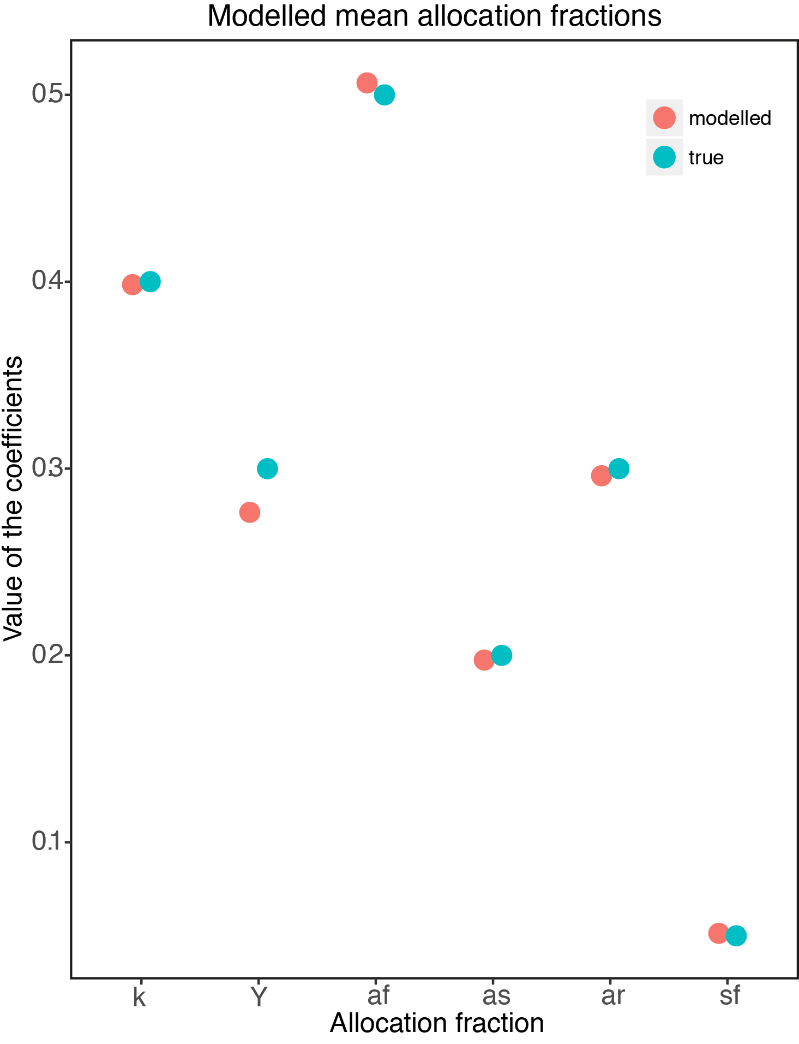

Synthetic case
LogLi = 14.6
AIC = -19.3
BIC = -13.2
Time = 112 sec
Cstorage modelled
Assigned parameters:
k = 0.4
Y = 0.3
a_{f} = 0.5
a_{s} = 0.2
a_{r} = 1 - 0.5 - 0.2 = 0.3
s_{f} = 0.05
Notes:
We test MCMC on our Carbon balance model (CBM) with a synthetic data set for an individual plant
We generate a GPP and respiration curve for 30 days
This example considers the simplest scenario; just one parameter set for 5 variables ("k","Y","af","as","sf")
So the parameters do not vary over time and these are the values we assigned for the parameters to generate the synthetic carbon stocks for 30 days and randomly we choose few points as final data points (shown in circles) in the left figure
The uncertainty bounds are also defined for all the data points
Now the lines represent the final modeled carbon stocks which satisfy all the measurements within their uncertainty
Looking at the values of assigned vs. modeled parameters we can see they are pretty much close to each other except the Y shows a bit of variation
We also calculate the LogLi, AIC, BIC, computational time to check the model performance and the values show acceptable efficiency

Slide 19
Hypotheses
Null hypothesis: The parameters don’t change with different treatments
Our hypotheses for the sink limitation experiment are that the plants with reduced sink strength would have:
Most importantly, a lower utilization rate (lower k). Under sink limitation, we would expect that the rate of conversion of photosynthate to biomass would slow down and the plant would increase its reserves.
We are also hypothesising more C lost to respiration and less used for production (higher Y) - this is the “wasteful plant” hypothesis, whereby C taken up by the plant that is unable to be used for growth is returned to the atmosphere. However, it is a questionable hypothesis.
Regarding the allocation fractions we would have expected lower root allocations since the plants physically don’t have room to grow more roots.
Notes:
Frist thinking about the sink limitation, how we would expect the parameters to change over time for different treatments.
The null hypothesis is that they don’t.
The effect of reduced sink strength is simply due to lower photosynthetic rate.
In that case, we would expect all the parameters to be the same.
Our hypotheses for the sink limitation experiment are that the plants with reduced sink strength (smaller pots) would have:
Most importantly, a lower utilisation rate (lower k). Under sink limitation, I would expect that the rate of conversion of photosynthate to biomass would slow down and the plant would increase its reserves. This seems to be supported in our results.
We are also hypothesising more C lost to respiration and less used for production (higher Y) - this is the “wasteful plant” hypothesis, whereby C taken up by the plant that is unable to be used for growth is returned to the atmosphere. It’s a questionable hypothesis, and doesn’t seem to have much support from our analysis.
Regarding the allocation fractions we would have expected allocation to roots to increase, due to limited resource availability, but now looking at our results with lower root allocation I figure that makes sense, since the plants physically don’t have room to grow more roots.

Slide 20
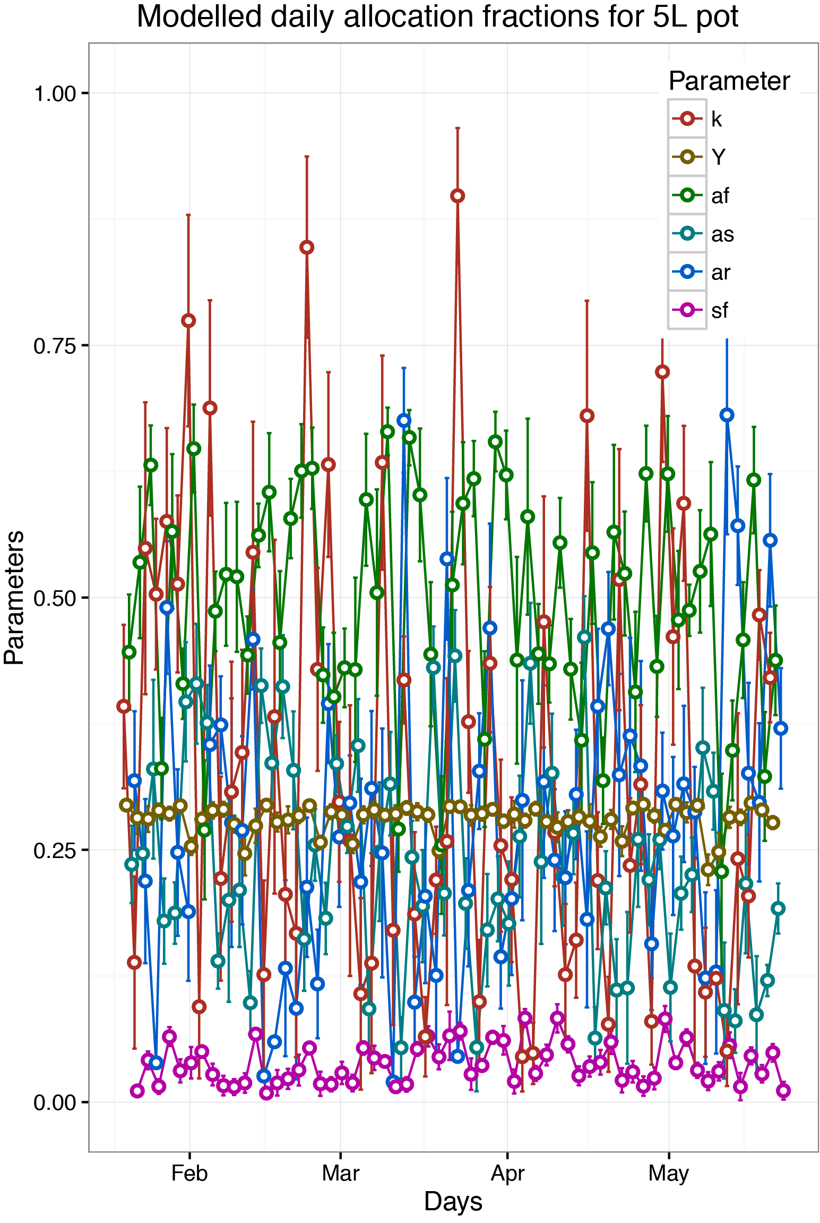
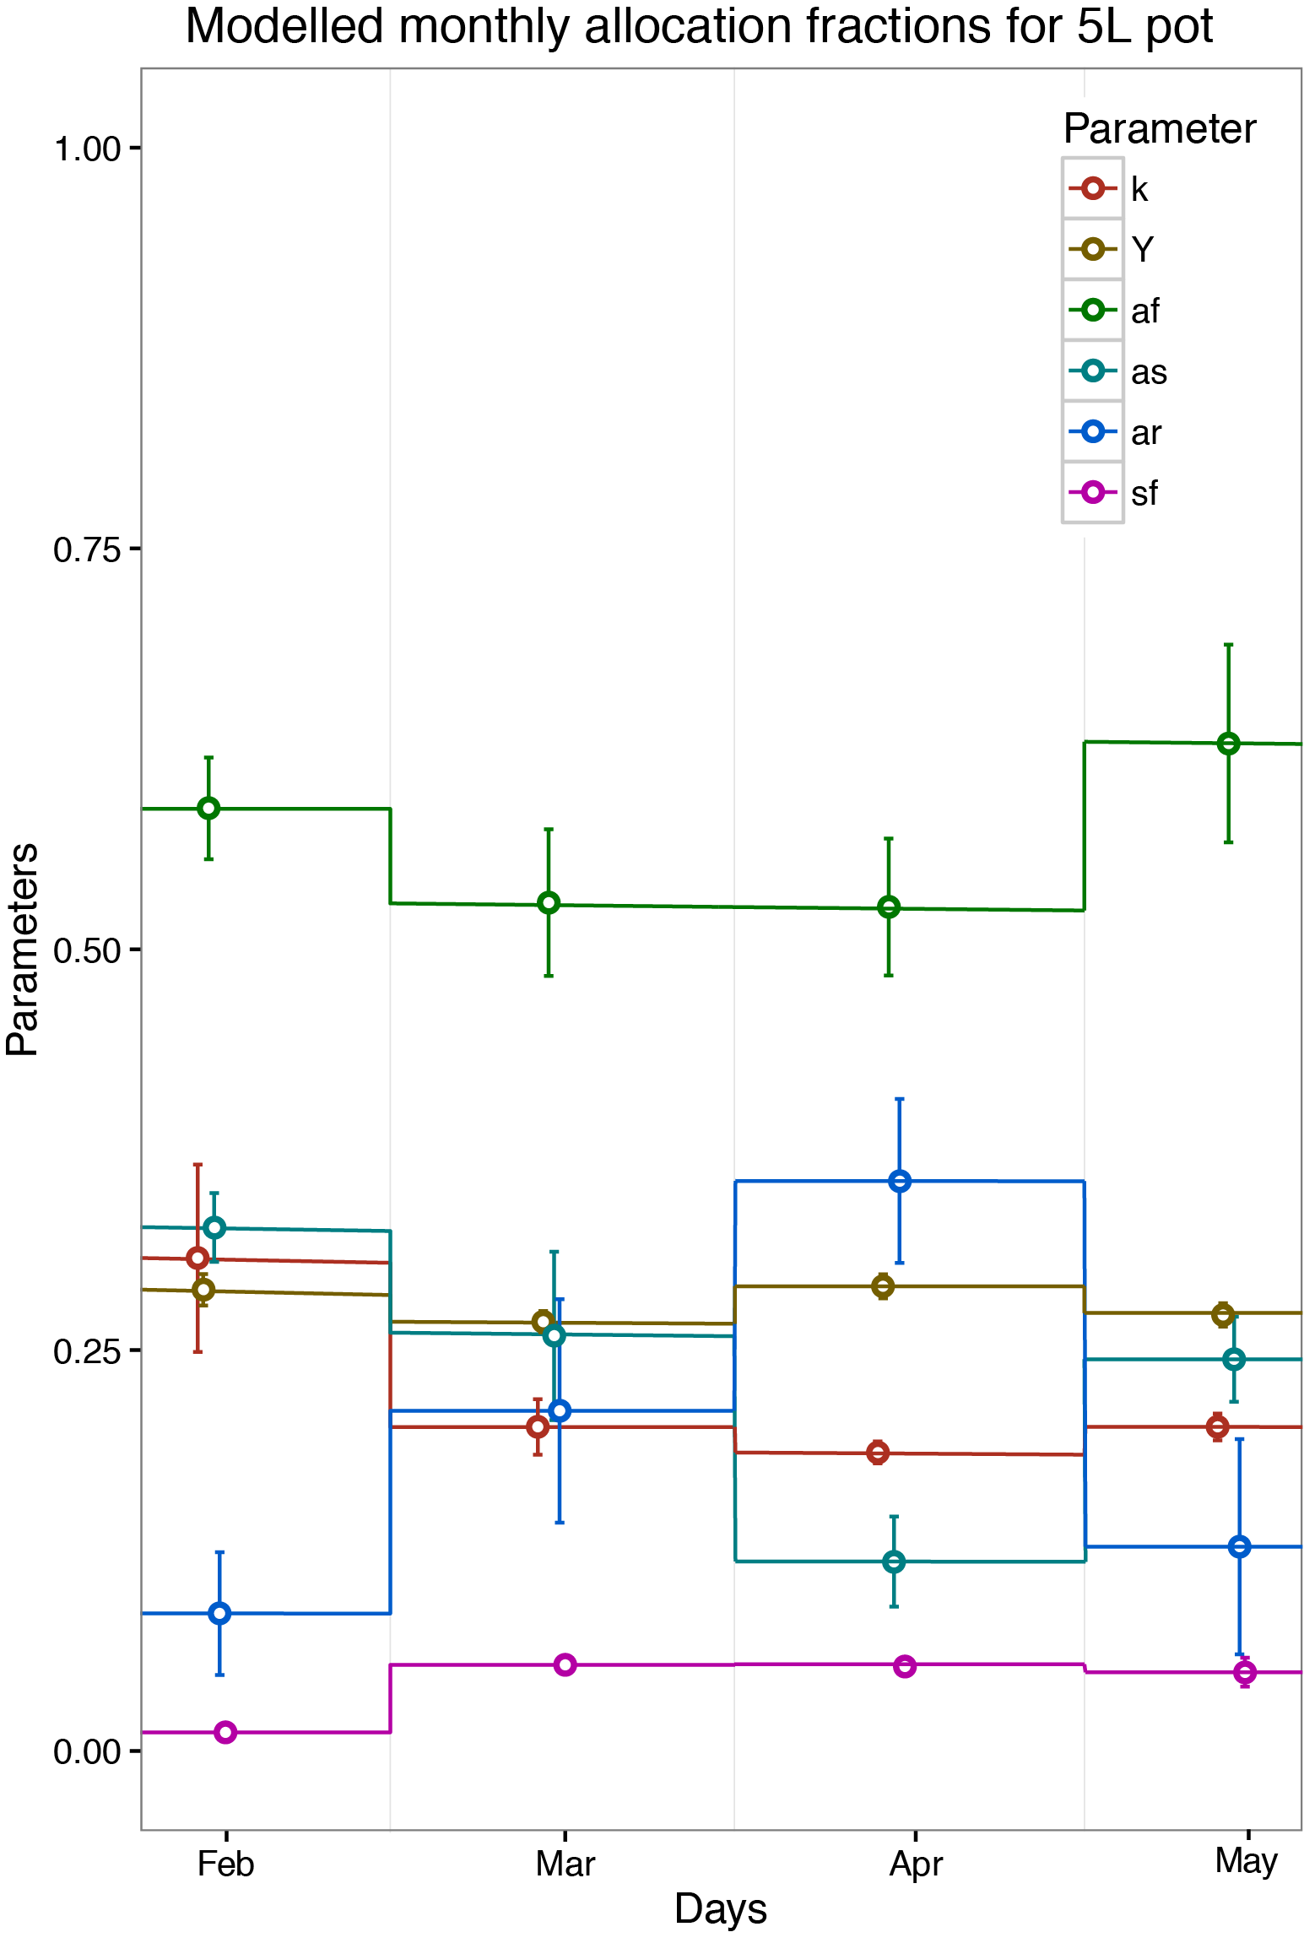
Parameter settings
Test case 1:
Daily parameter set
Test case 2:
Monthly parameter set
Notes:
When we are satisfied with the results from the synthetic case, we jump into the real scenario
Now the hardest part in to how to setup the parameter settings, do we go for daily variation, monthly or what else??
So we started our testing with daily variation where the parameters can vary daily over time within the defined parameter space
Here is an example how it worked with all the parameters go up and down with time to match the modeled carbon pools with the data measurements
So this look certainly messy and we don’t want the parameters to vary that abruptly
Then we tried monthly variation and the results were similar though the parameters don’t vary within that month, however change suddenly from one month to another

Slide 21
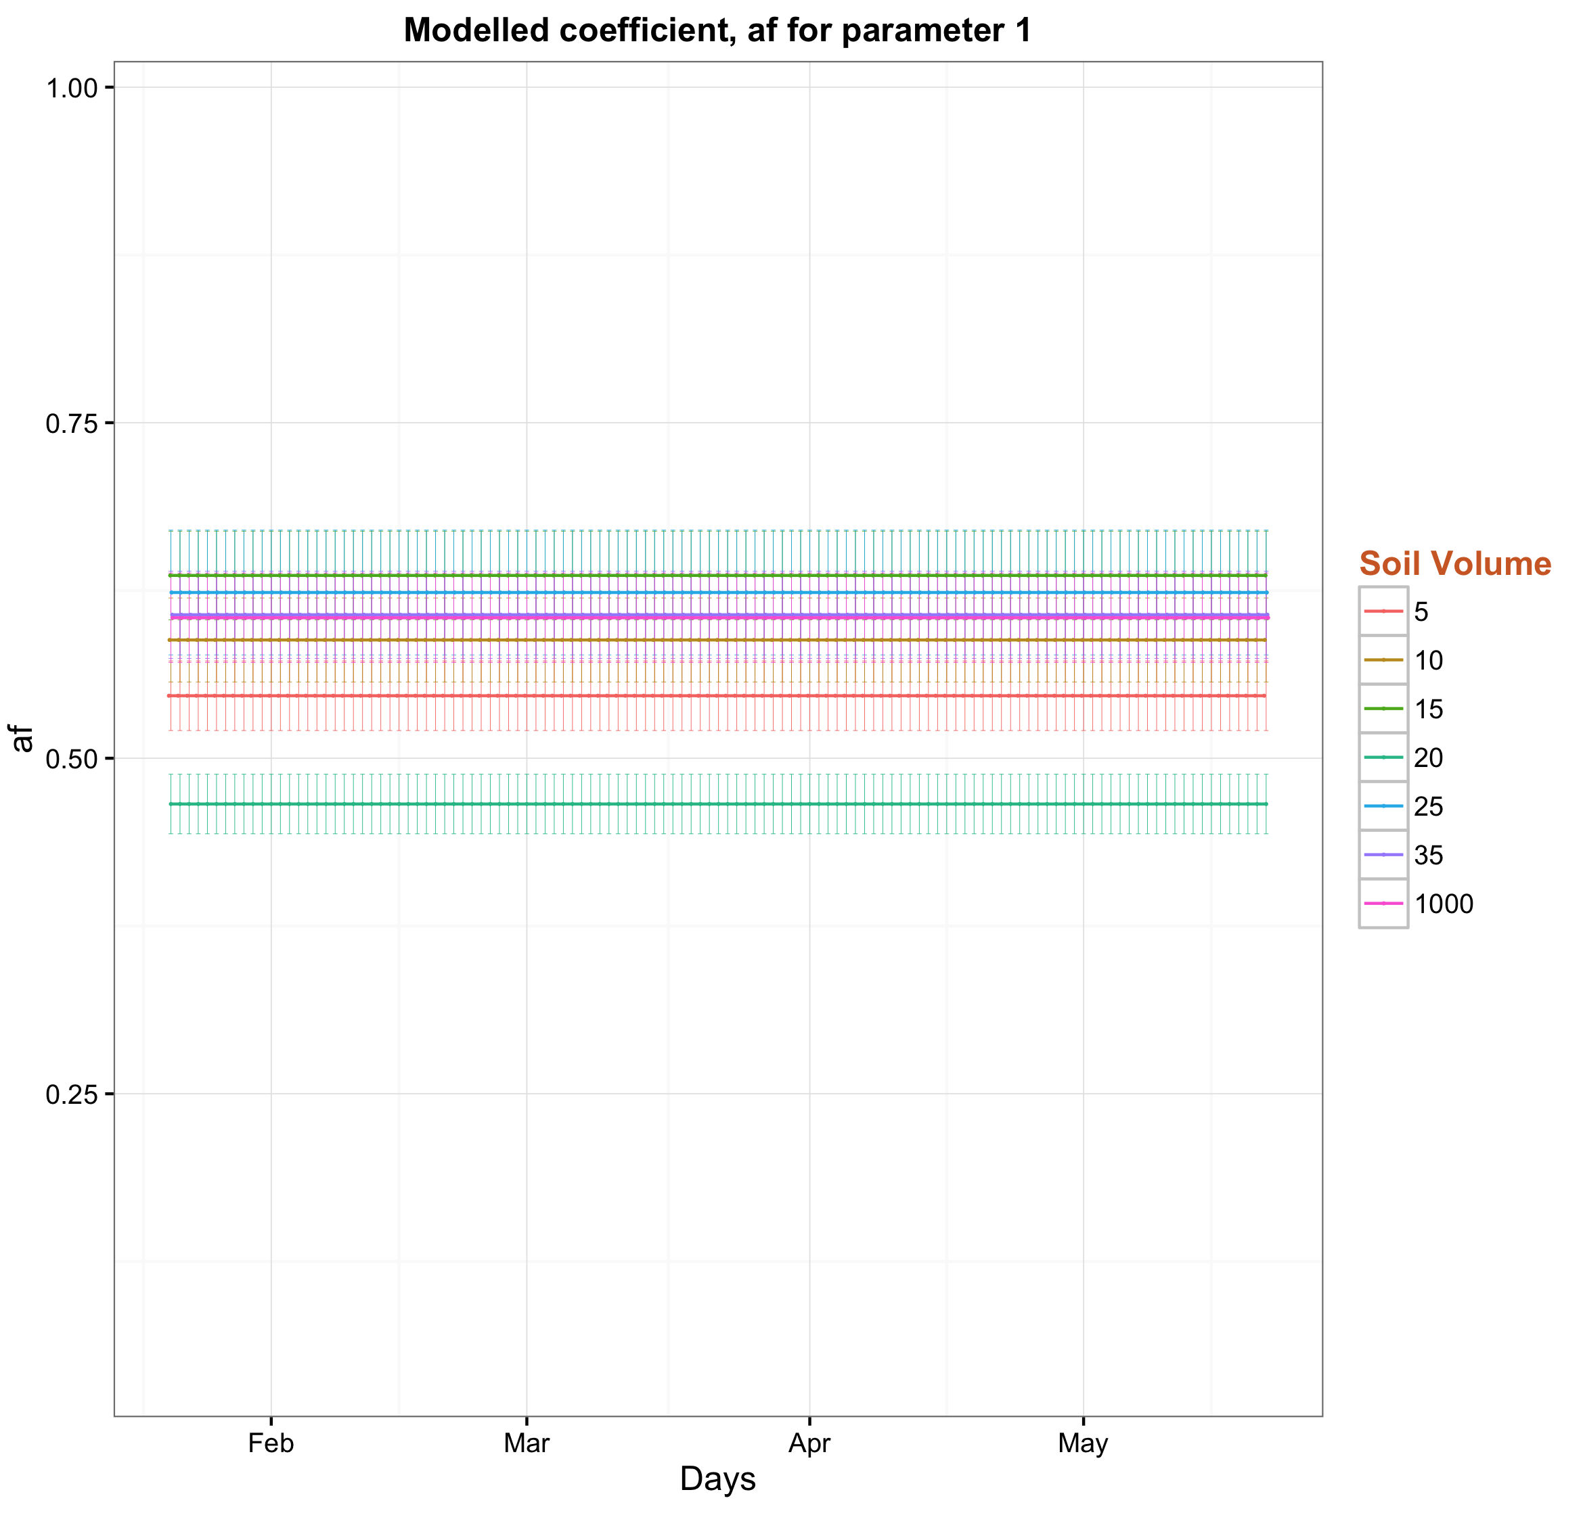
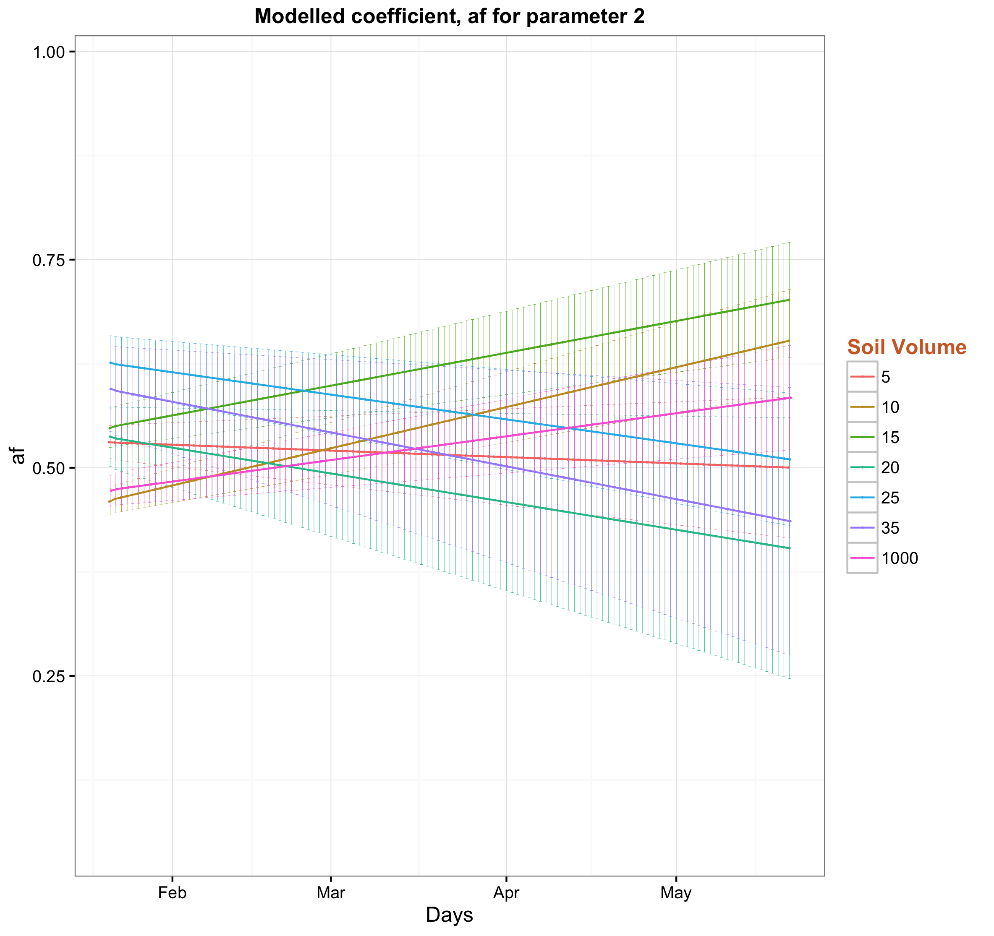
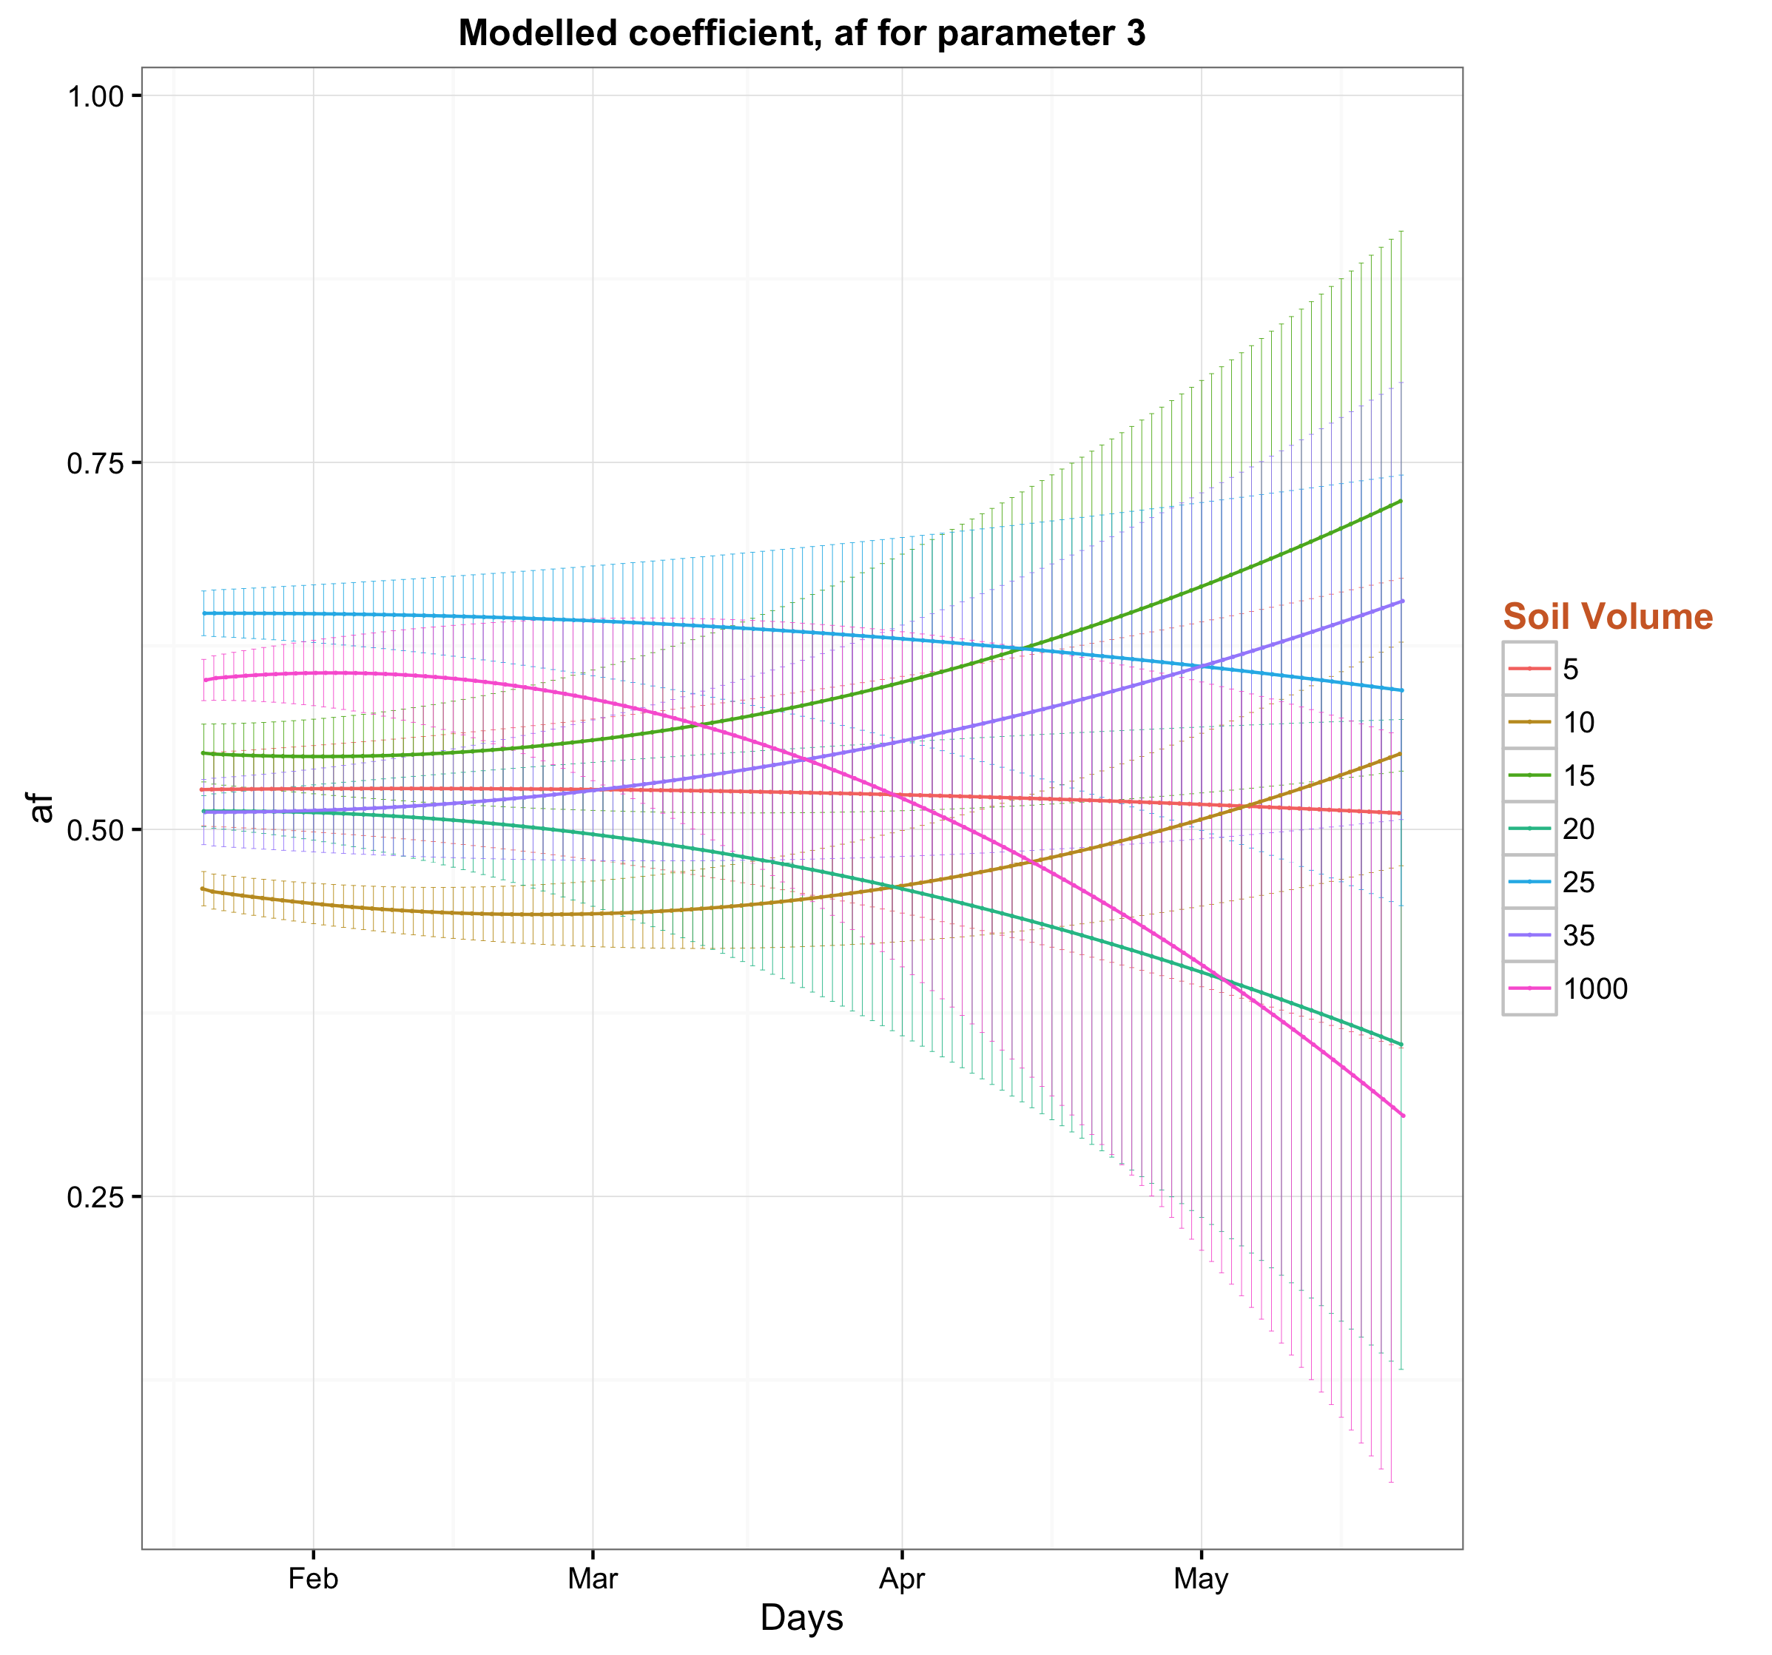
Parameter settings
Test case 4:
Two parameter sets
k = k₁*t + k₂
Test case 5:
Three parameter sets
k = k₁*t² + k₂*t + k₃
Test case 3:
One parameter set
Notes:
So to get rid of these sudden changes we then test few other scenarios starting with the most simplest form:
That is the case 3 where we have only One parameter set – so the parameters don’t vary over time.
The uncertainty around the estimates are also modeled and shown with light colors.
This option could also fit the model with the measurements, however with lower Log likelihood and higher values of AIC, BIC.
And most importantly this option doesn’t fulfill the aim of time varying parameters.
So we quickly move on to the next step where we have the parameters vary linearly over time, therefore we need to infer two sets of parameters in this case (k1, k2 and so on).
These results also show a bit of hard time to satisfy the data with lower Log likelihood and higher values of AIC, BIC.
Then we did the similar test with 2nd order quadratic equations with three sets of parameters (k1, k2, k3 and so on).
This case shows better matching with the data when we compare the log likelihood, AIC and BIC.
So to finding the optimum parameter settings for our model, we did the iterations with 4 parameters as well, however don’t get any clear improvements at all comparing with the test case 5.
So we can now conclude that test case 5 is the best parameter setting for our model with optimum results.

Slide 22
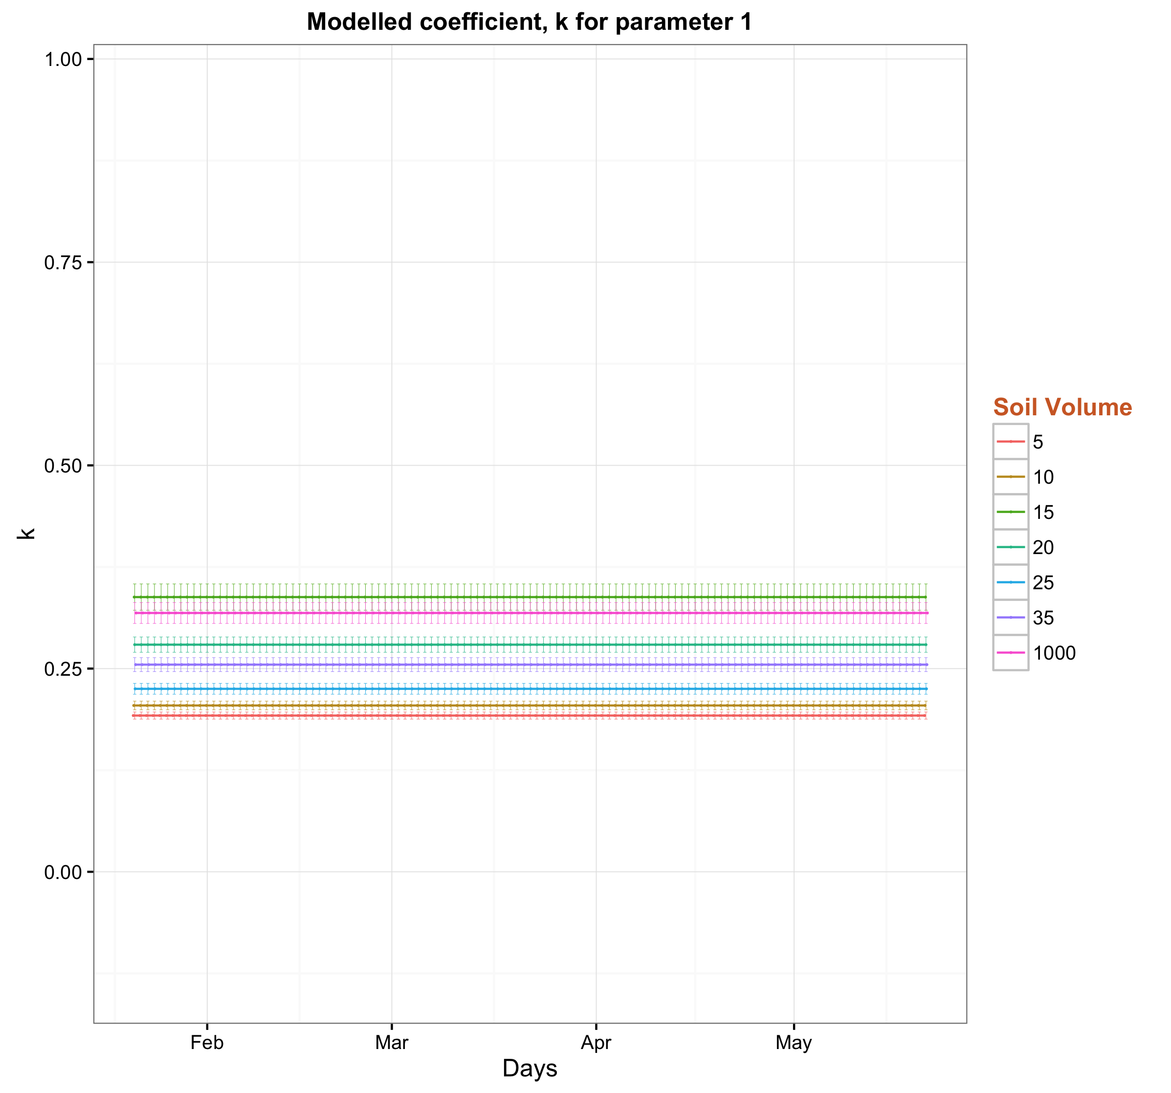
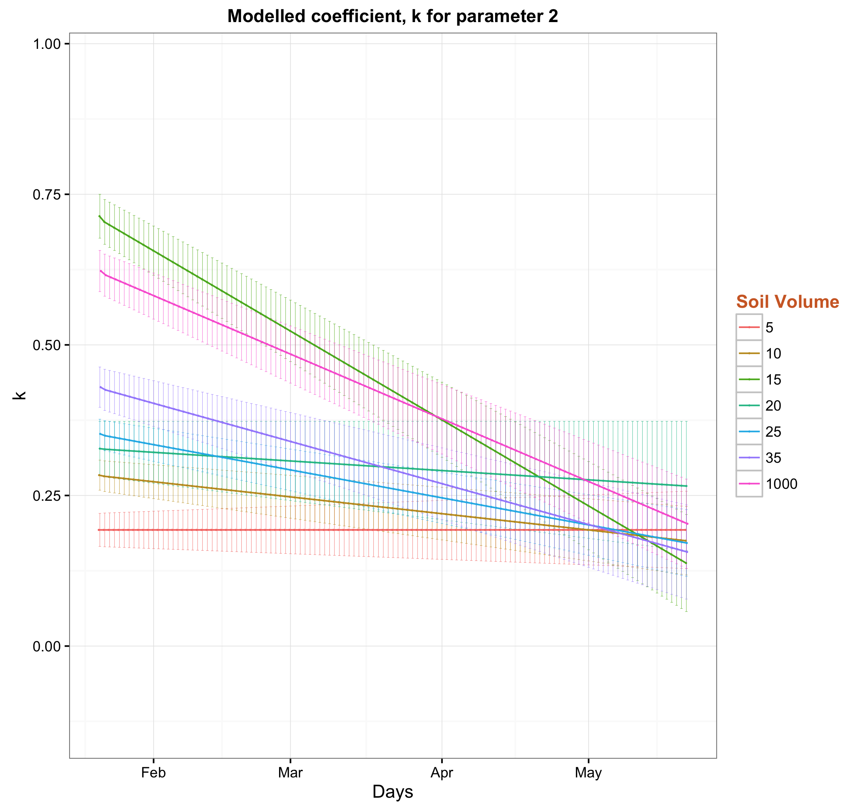
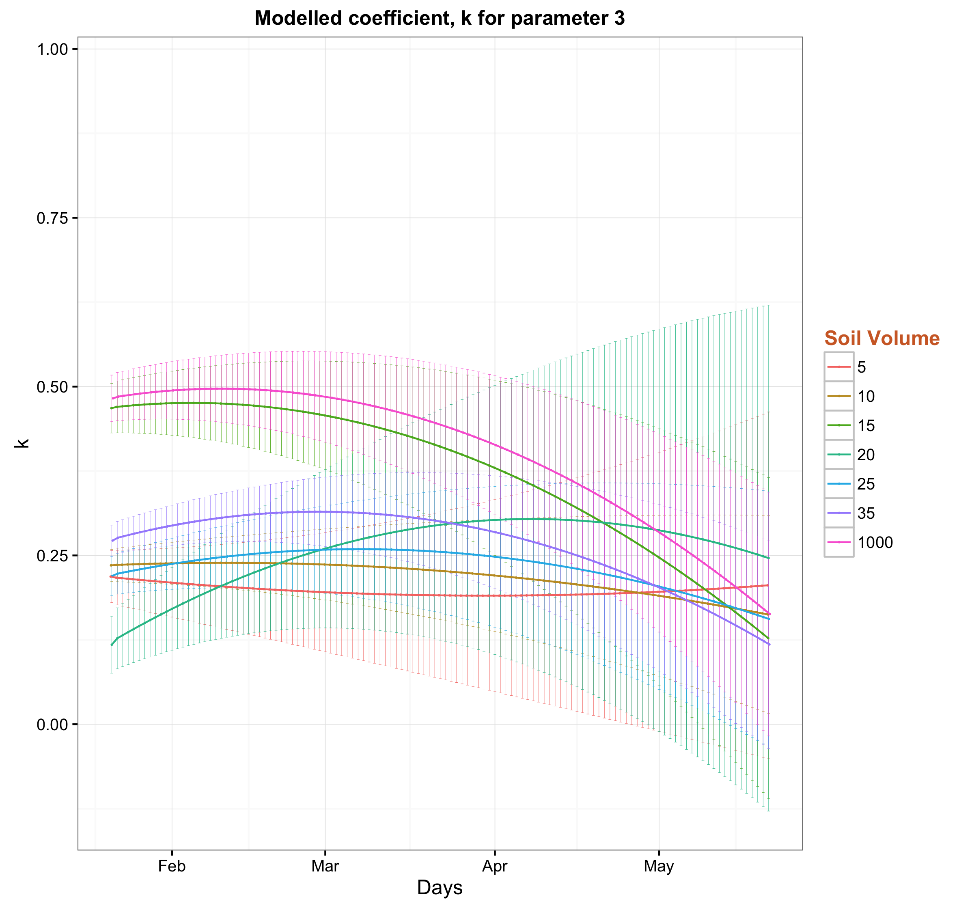
Parameter settings
Test case 4:
Two parameter sets
k = k₁*t + k₂
Test case 5:
Three parameter sets
k = k₁*t² + k₂*t + k₃
Test case 3:
One parameter set
Notes:
Similar diagrams with utilization coefficient “k”

Slide 23
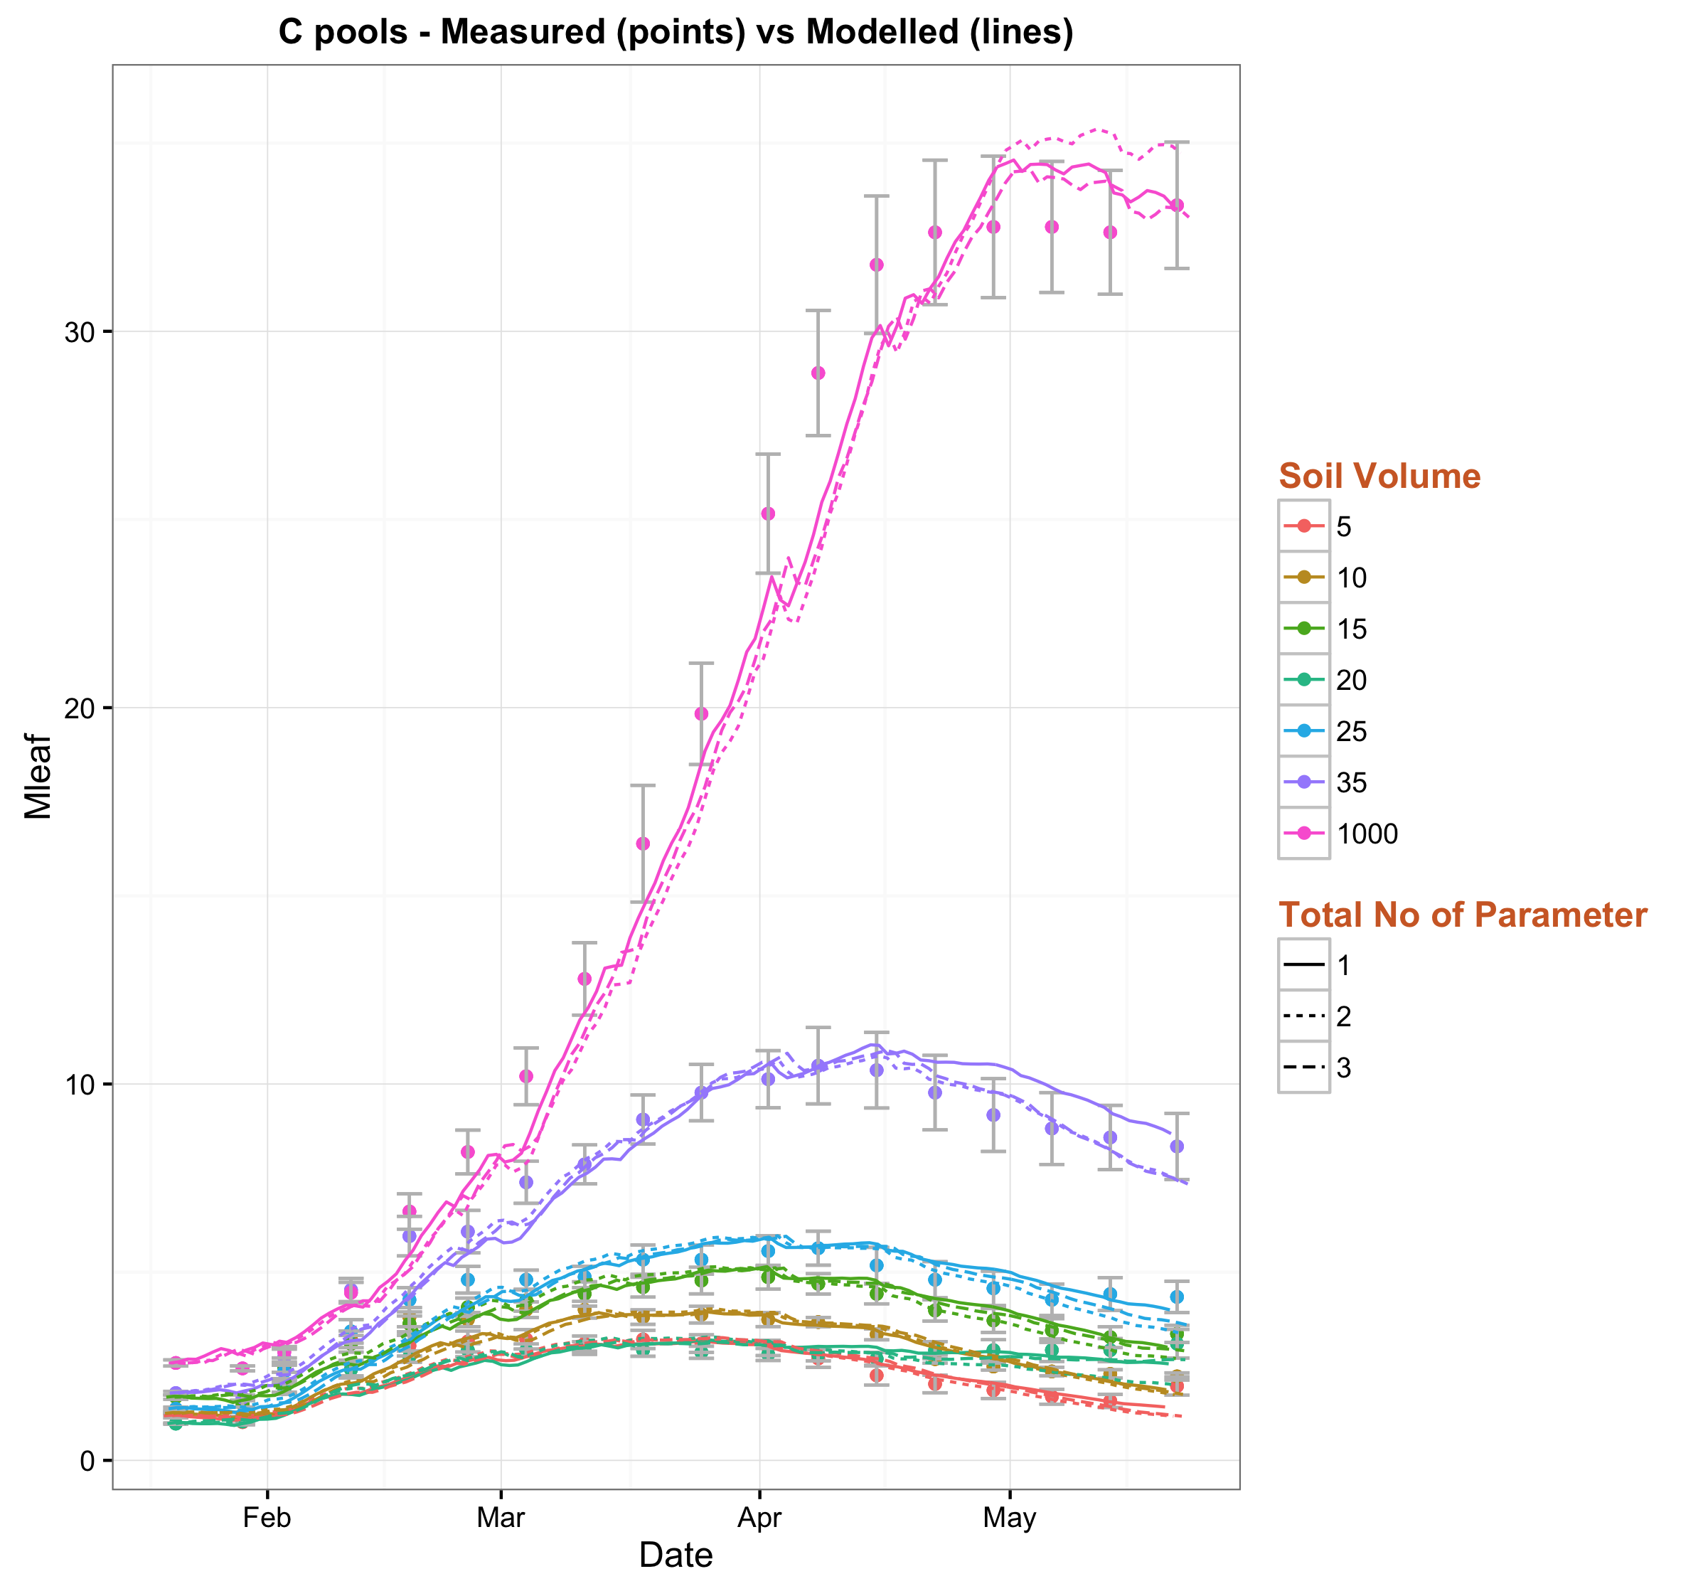
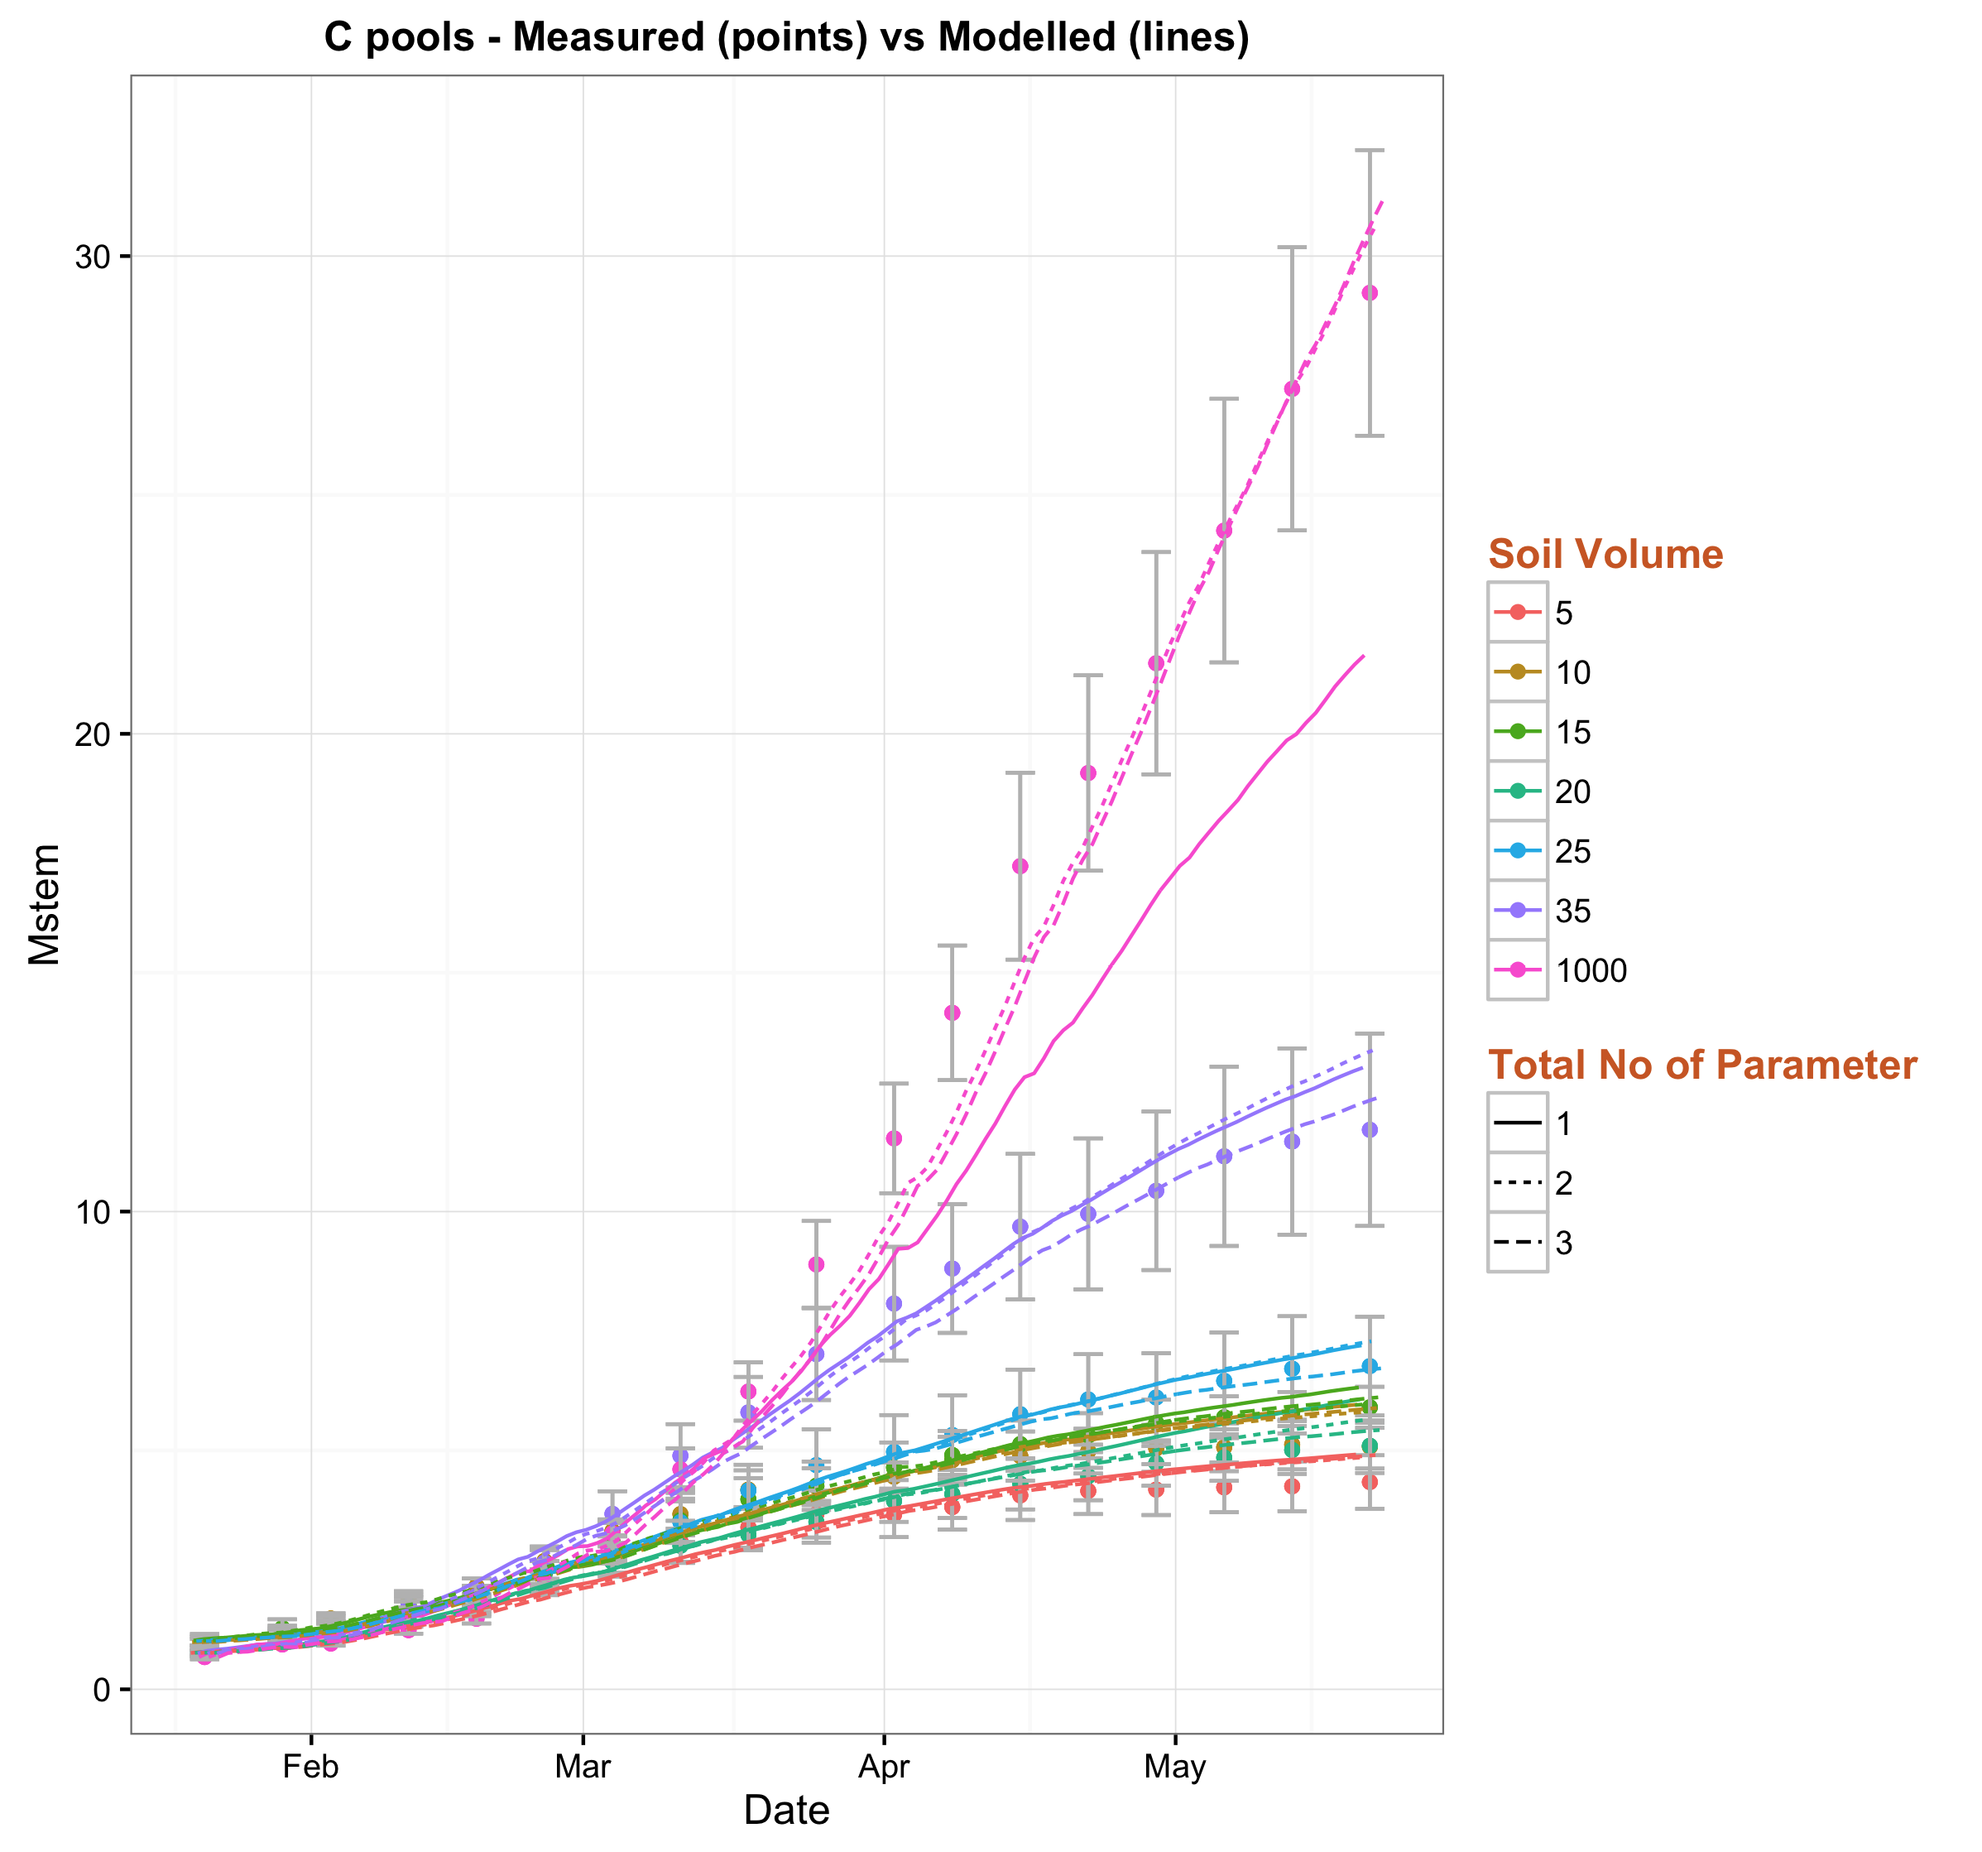
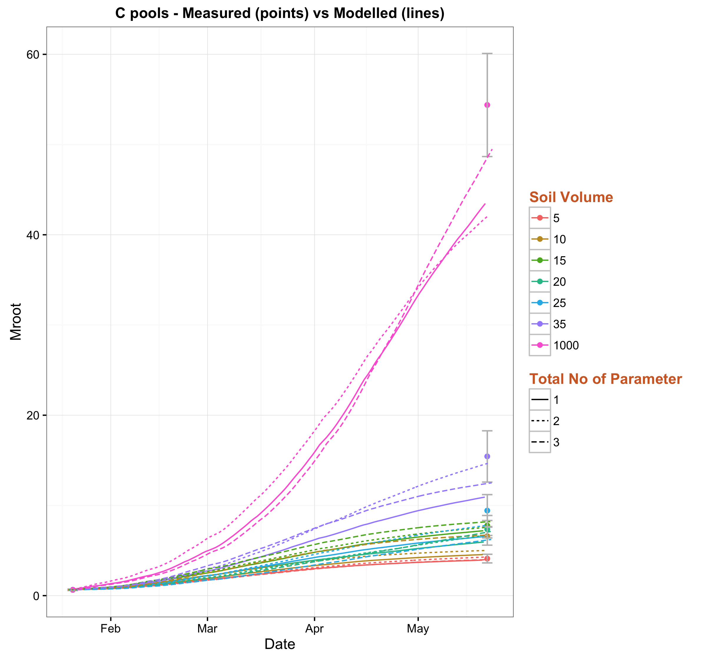
Parameter settings
Test case 3: One parameter set - Solid lines
Test case 4: Two parameter sets (k = k₁*t + k₂) - Small dashed lines
Test case 5: Three parameter sets (k = k₁*t² + k₂*t + k₃) - Large dashed lines
Notes:
The modeled biomass carves for all the treatments further establish that the case 5 with 3 parameter sets is the most suitable one.
The solid lines are for case 3 with no variation, small dashed line is for case 4 and the big dashed line represents case 5.

Slide 24
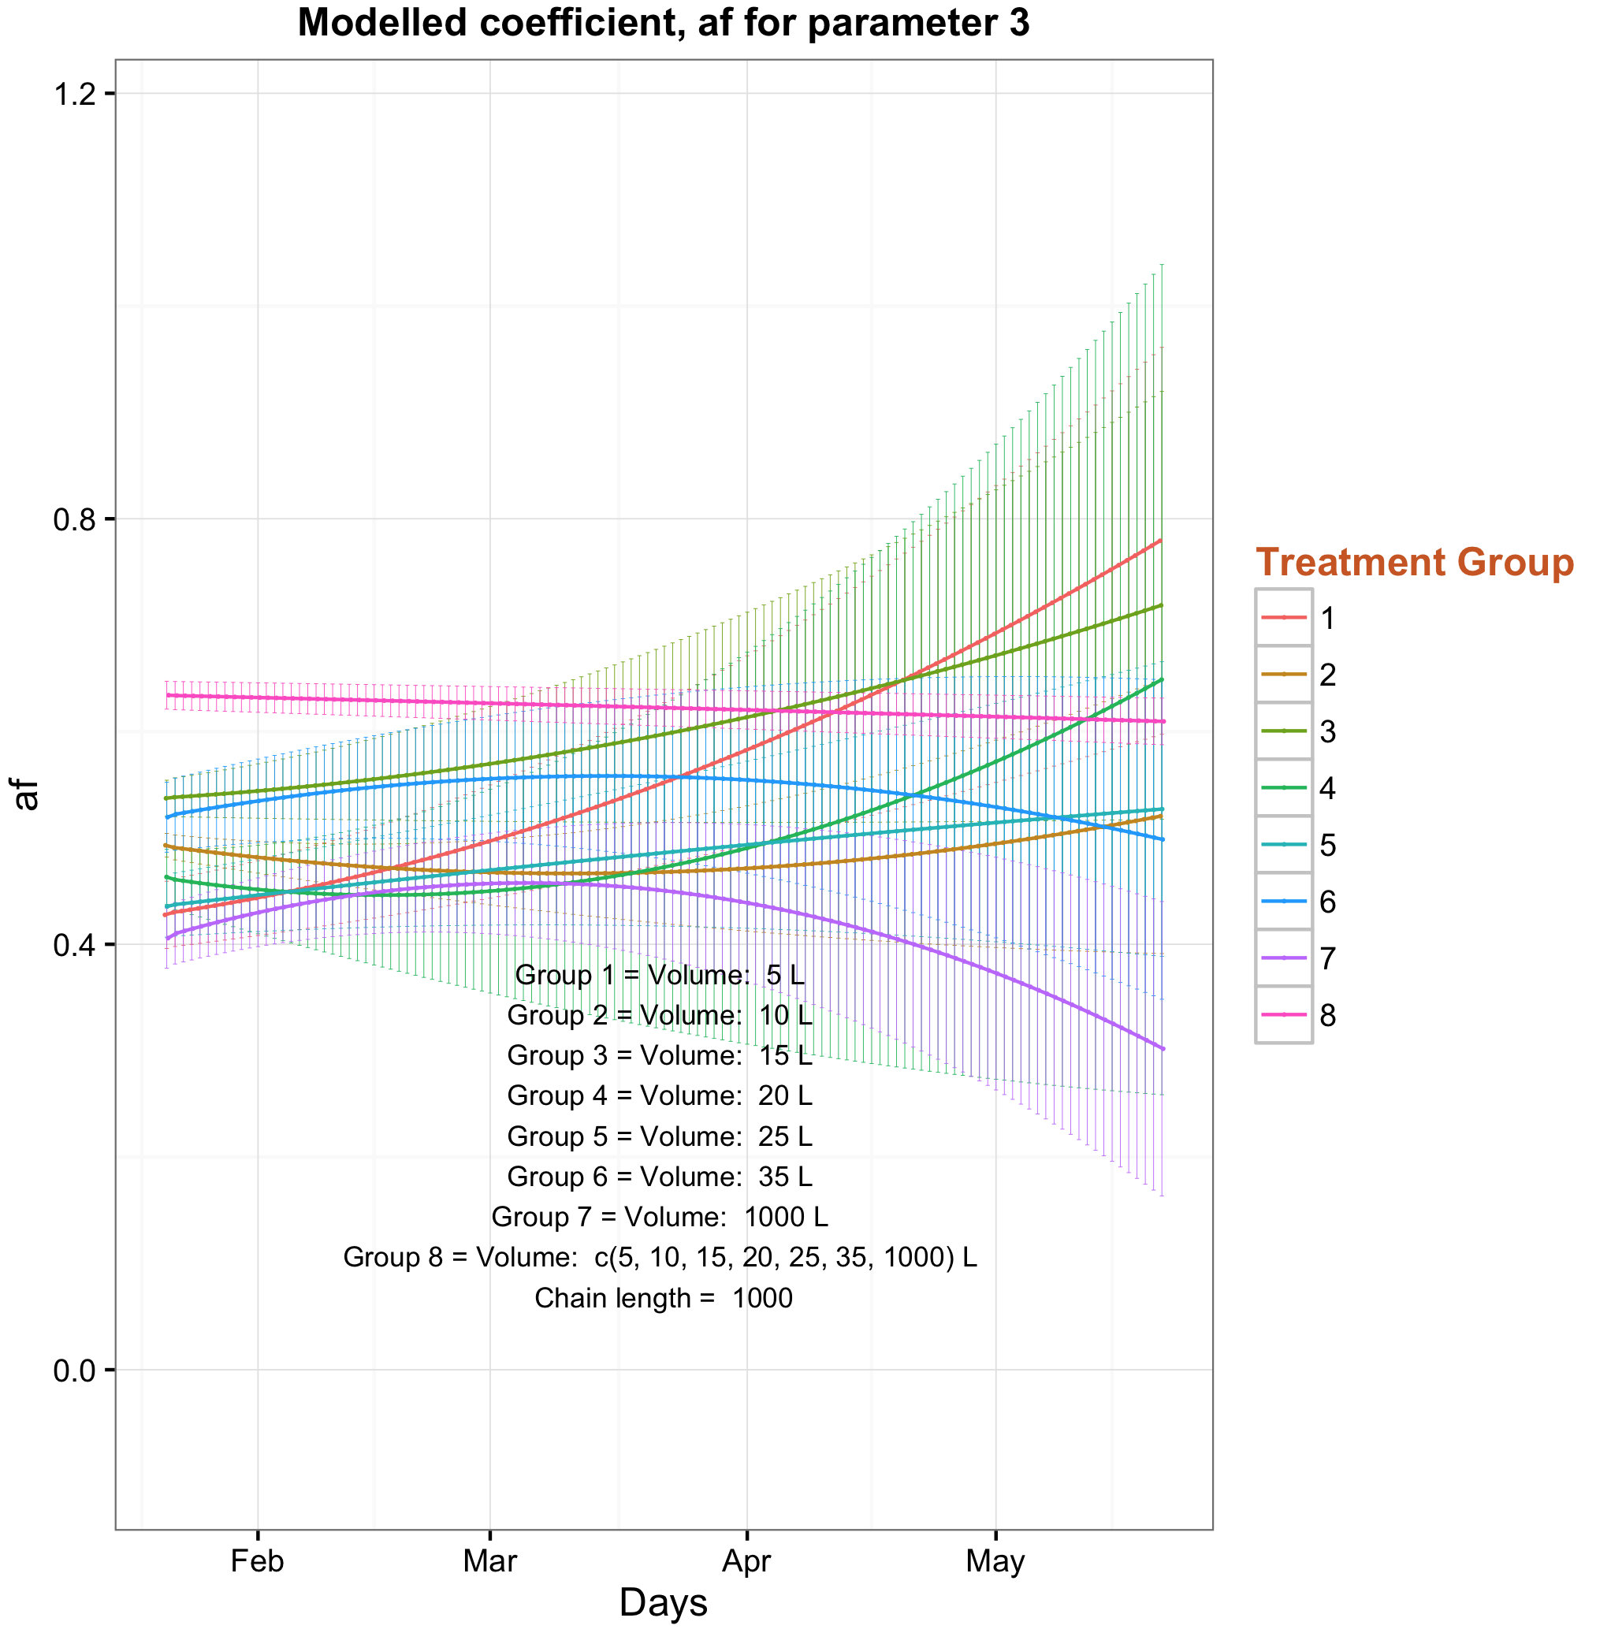
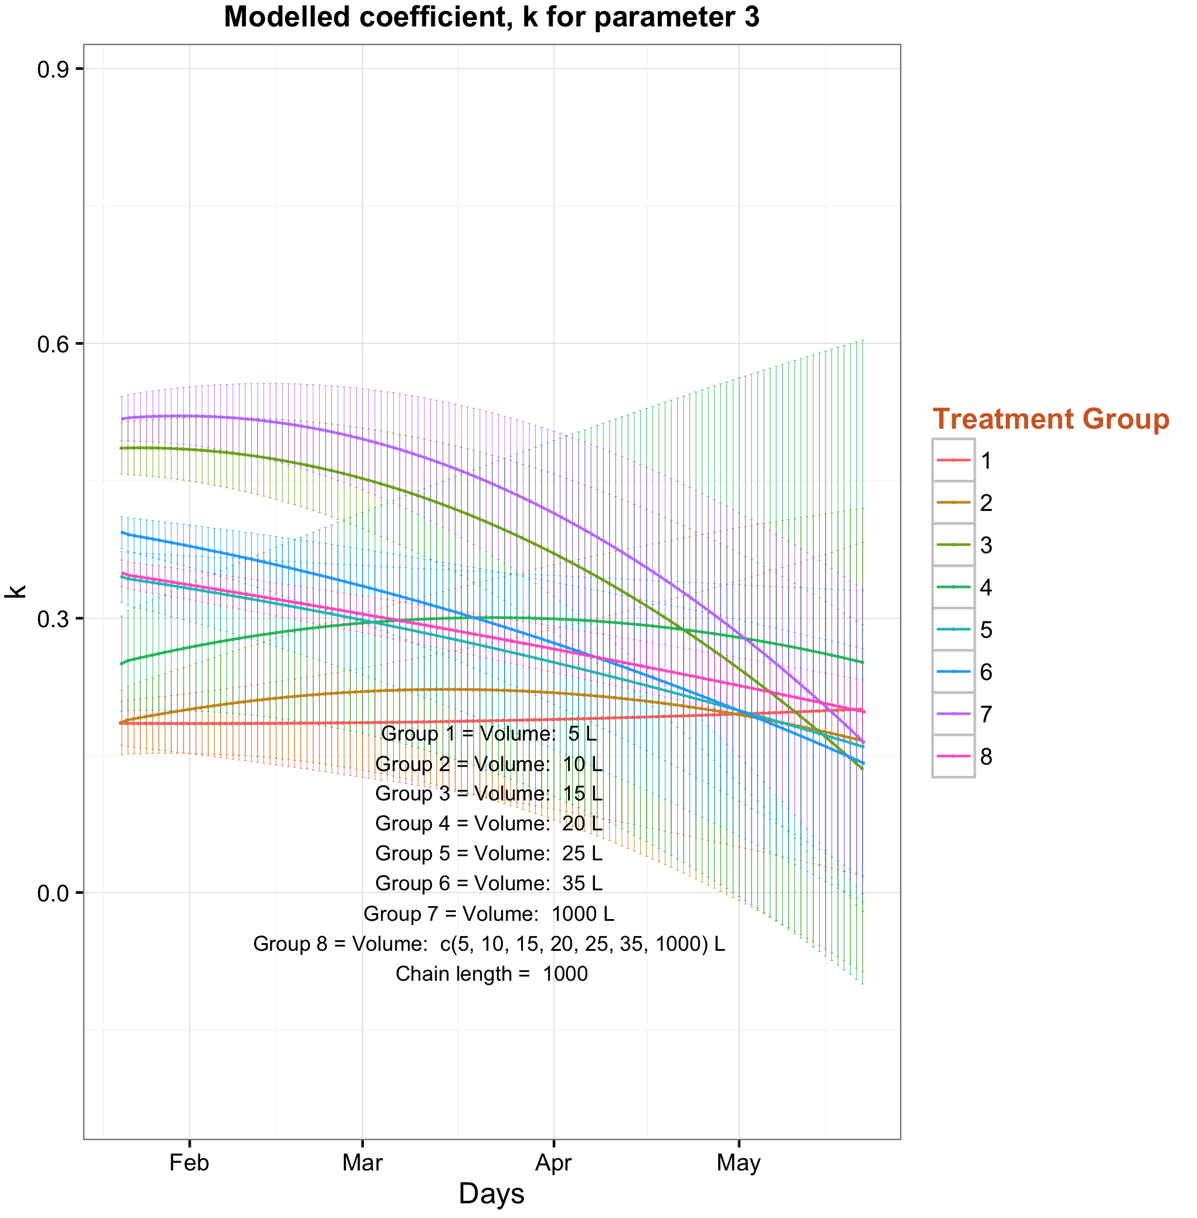
Findings
?? Null hypothesis ??
Parameters don’t change with different treatments
Notes:
Now let’s go back to our hypotheses list and start with the null hypothesis
We test what if the parameters are fitted to all groups at once (group 8 with pink color), and how far off would the parameters are for the different treatments (other curves)
I have just put the results for two of the parameters (af and k) and all the parameters clearly demonstrate the null hypothesis to be wrong as there are significant variations between the parameters for different treatments over time

Slide 25
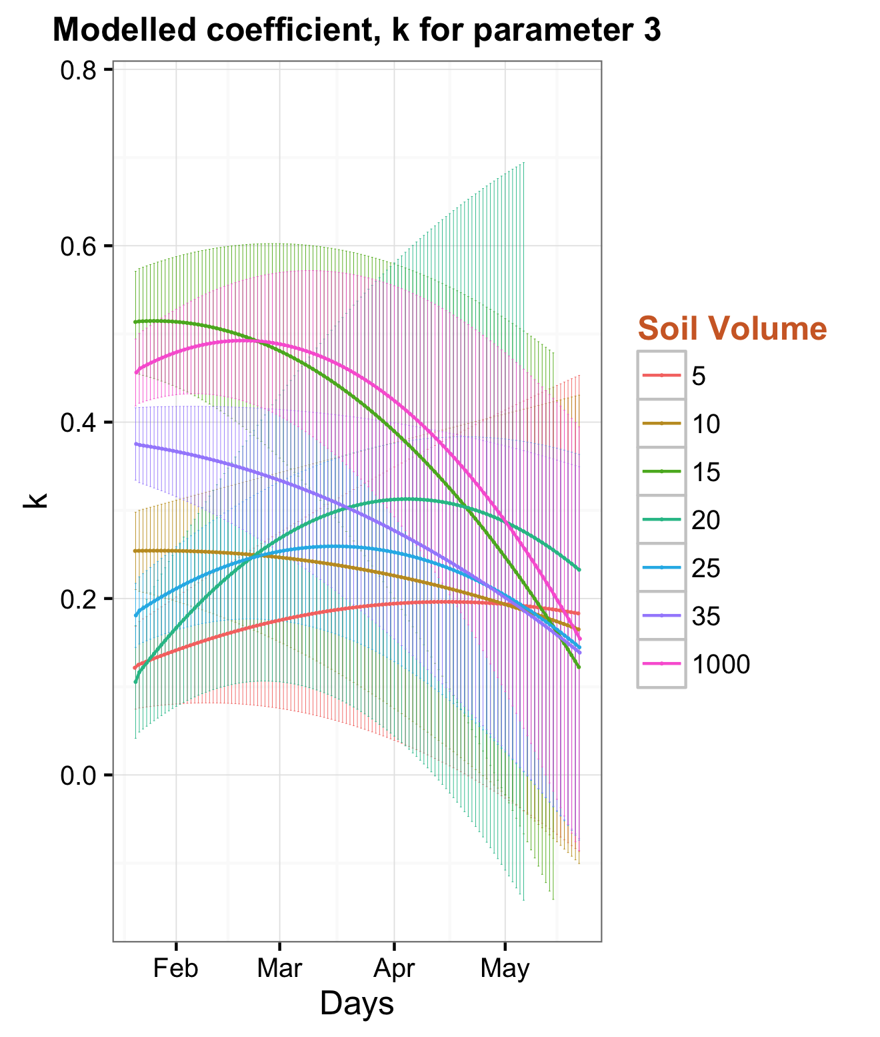
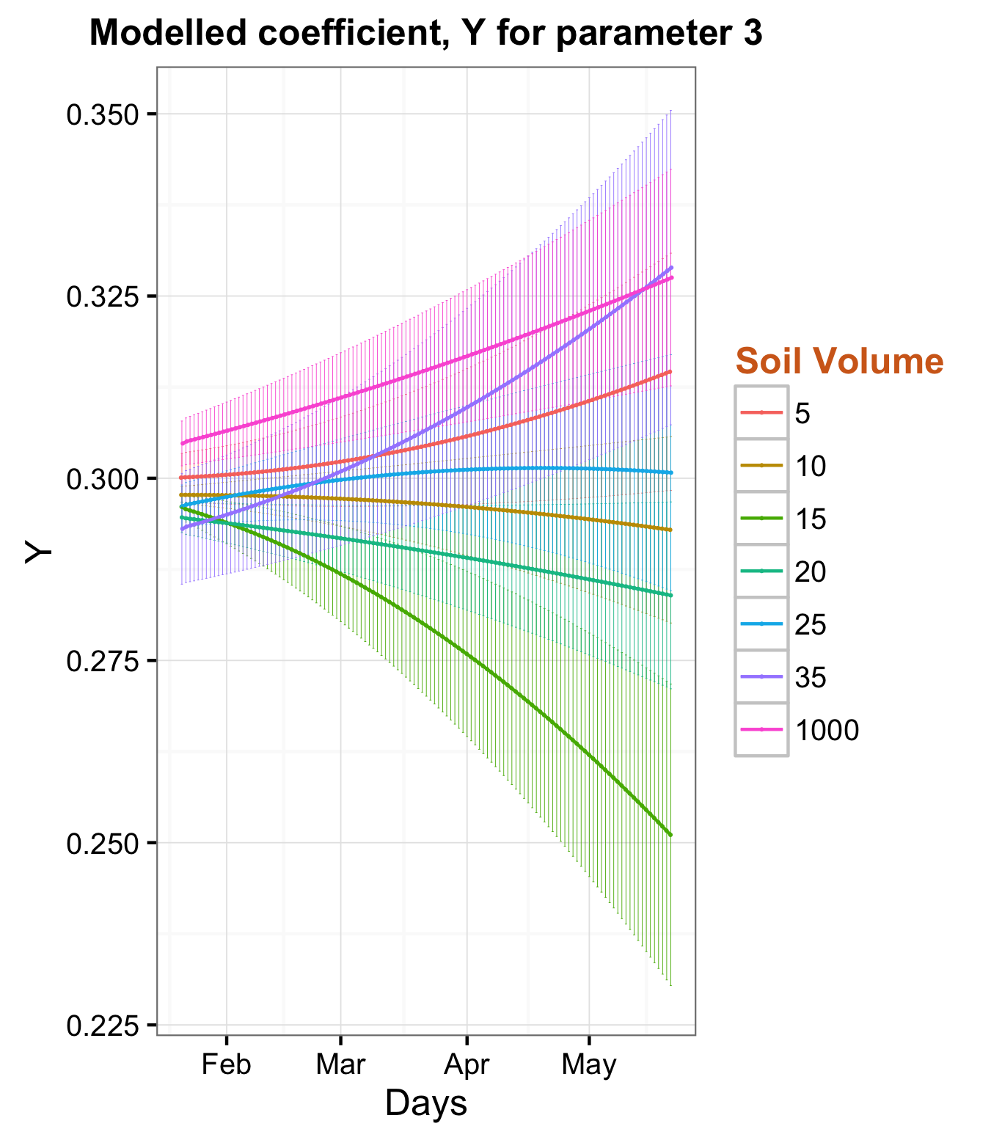
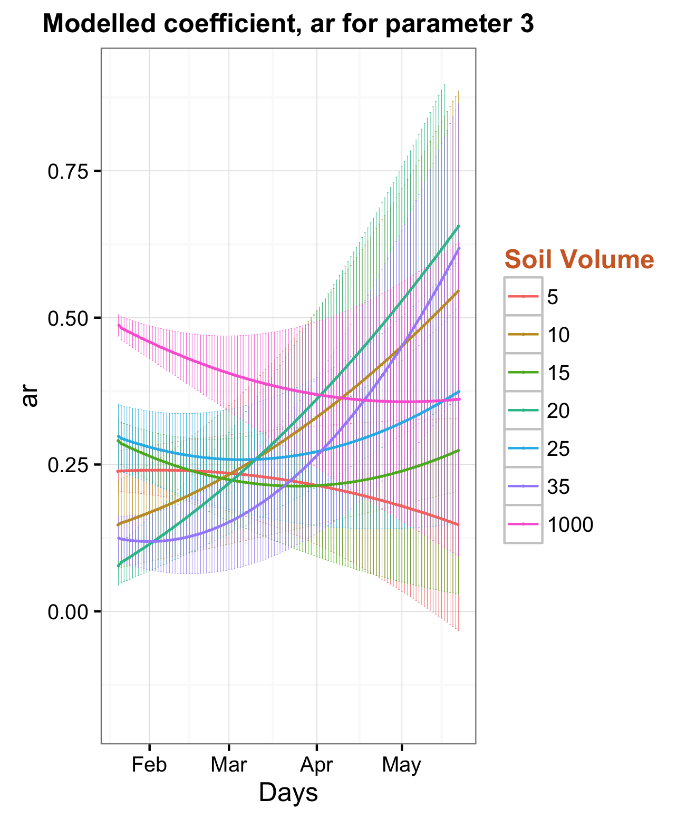
Findings
Other Hypotheses: 1. Smaller pot ➔ lower k ➔ higher Y
2. Low a_{r}
Notes:
Now if we think about the other hypotheses we listed for k, Y and ar, it gets kind of mixed up with all these 7 treatments and becomes hard to draw the conclusions
Too many samples are not always helpful!!

Slide 26
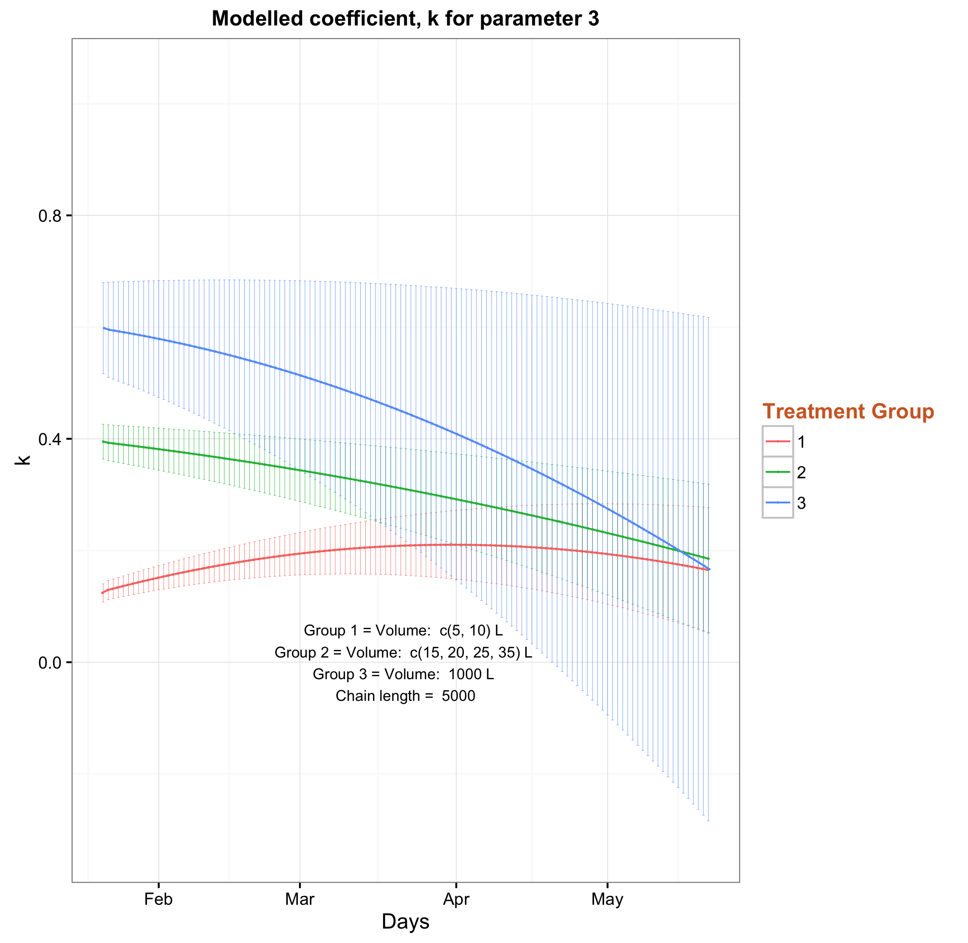
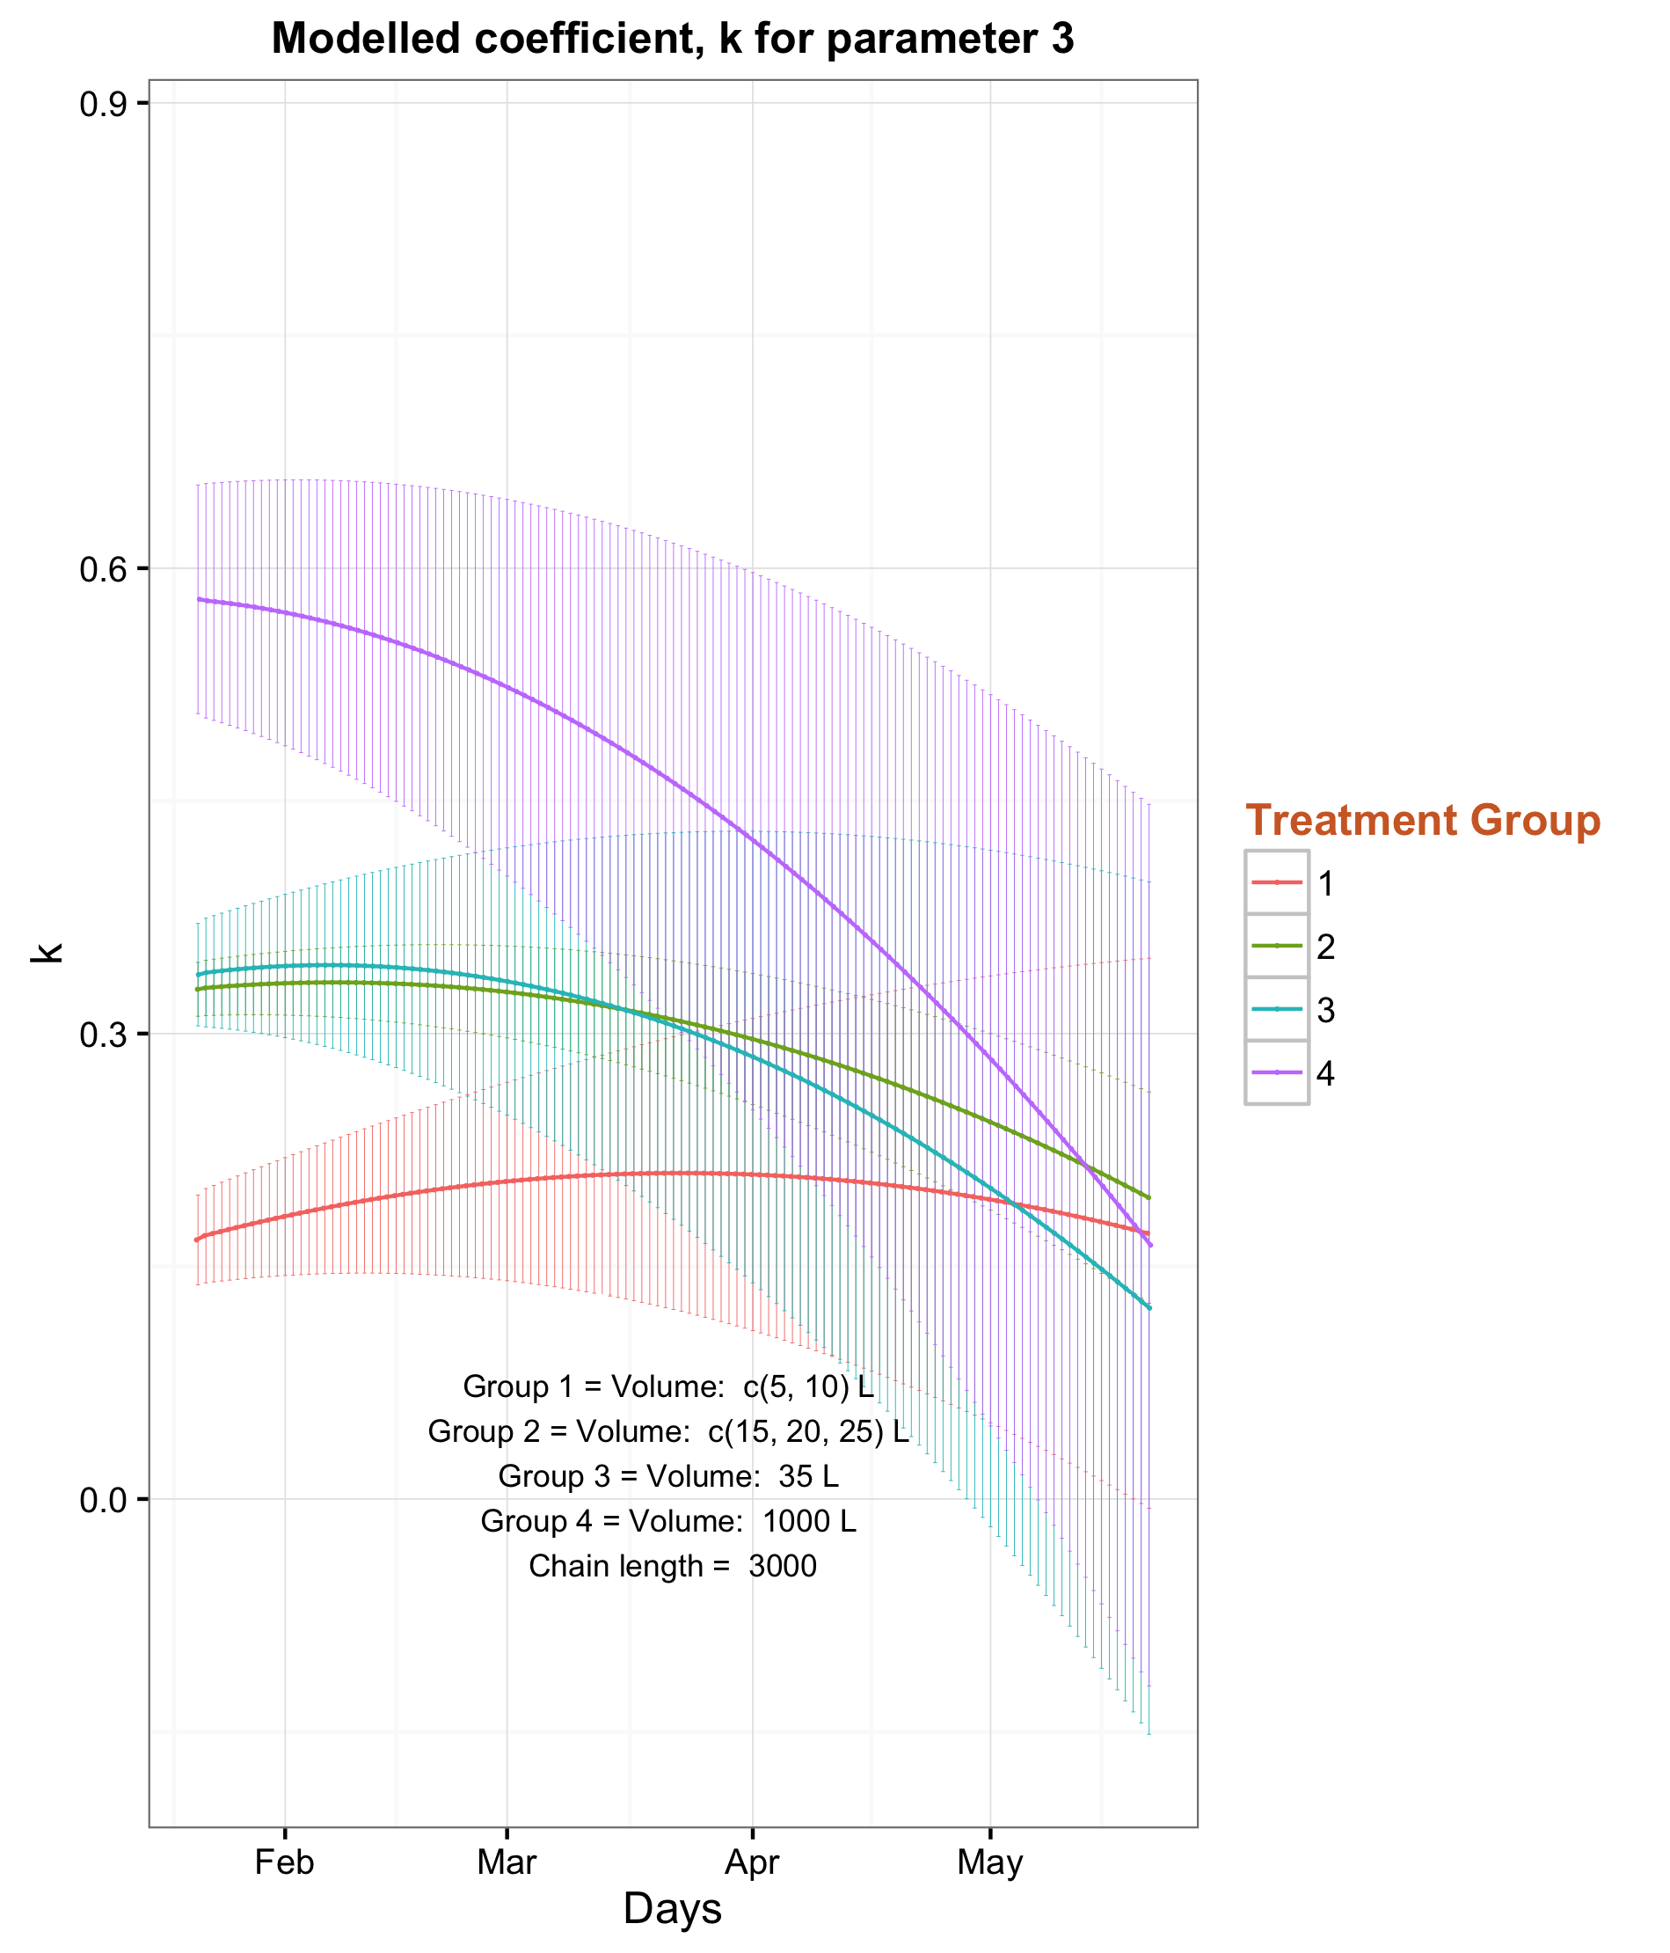
Findings
3 groups of treatments
4 groups of treatments
Notes:
So the next thing we do is make groups of treatments to simplify the results with fewer number of treatment groups and see how we could interpret the outcomes
Here are two of the examples having 3 and 4 cluster of groups in search of possible relationship between the sink strength and the parameters.
This slide shows the utilization coefficient k
It is evident that sink strength is proportional with utilization coefficient, supports our hypothesis #1

Slide 27
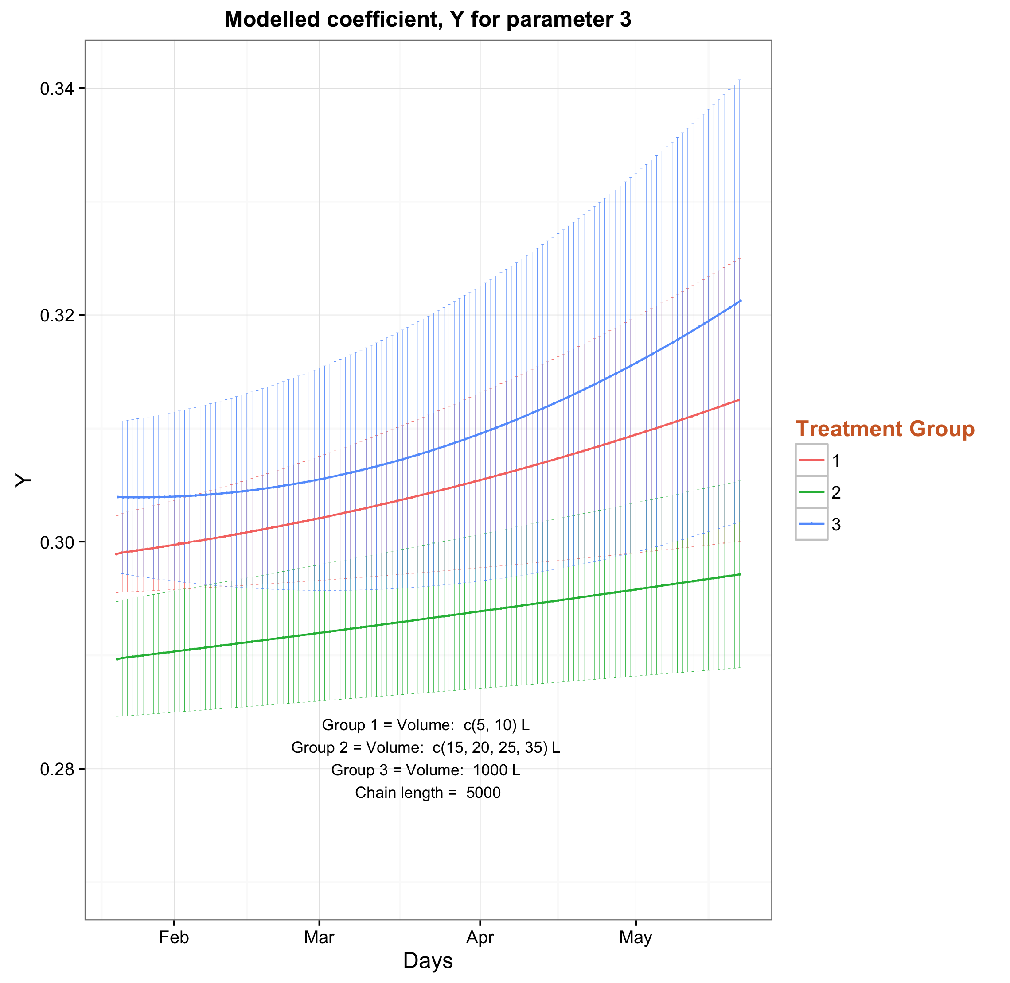
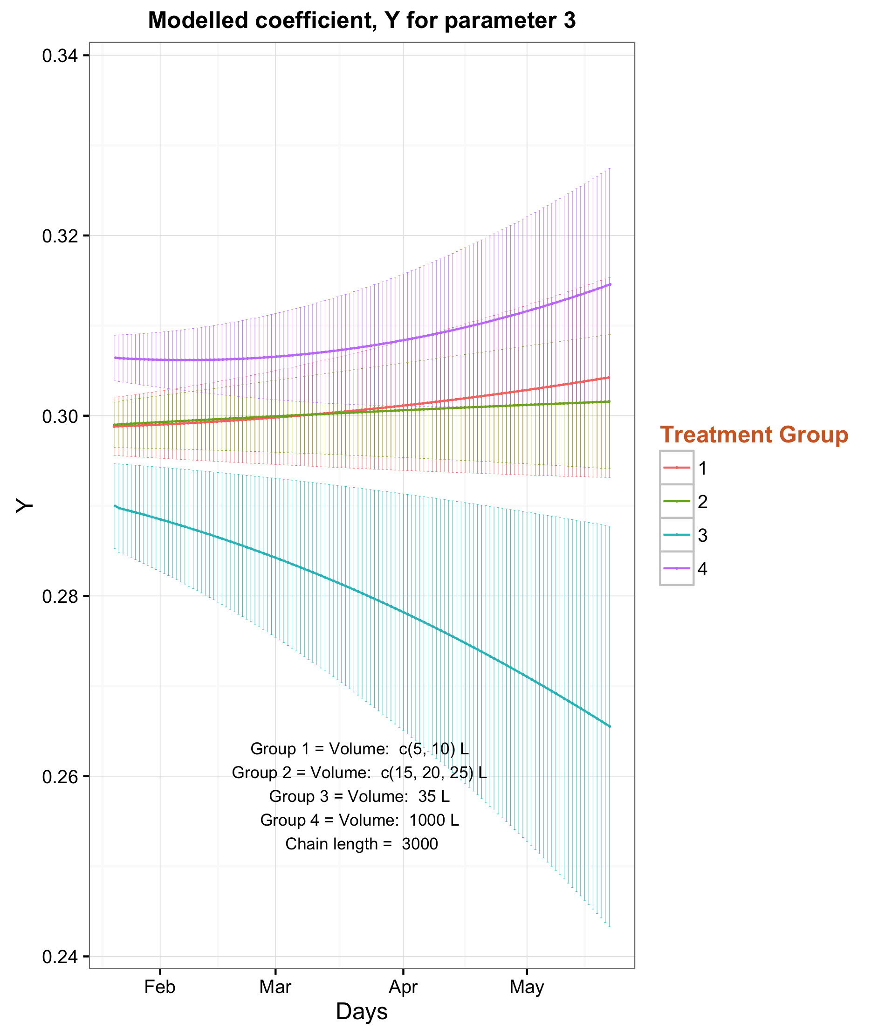
Findings
3 groups of treatments
4 groups of treatments
Notes:
Here are similar cluster of groups showing the growth respiration coefficient Y
There isn't any concrete relationship between sink strength and growth respiration coefficient Y, which makes the “wasteful plant” hypothesis more questionable.

Slide 28
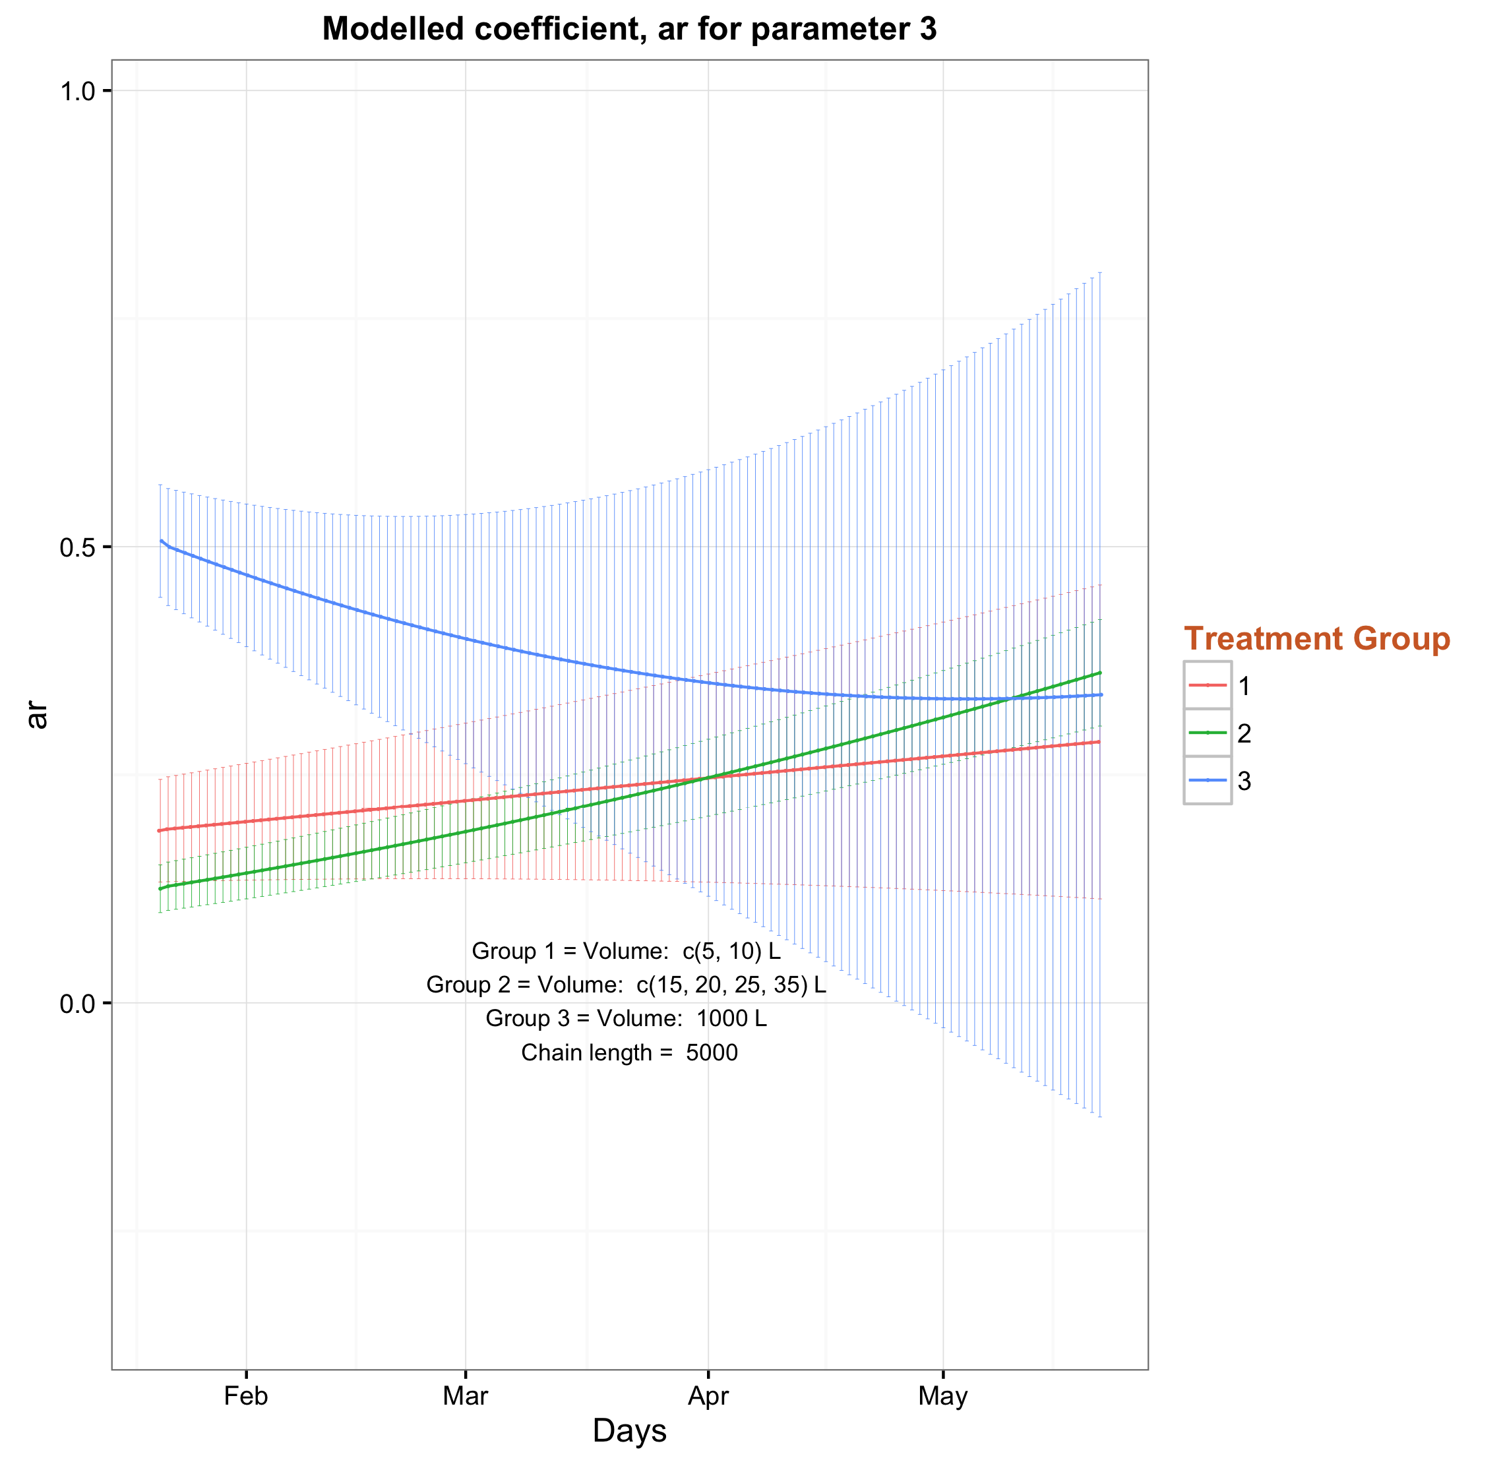
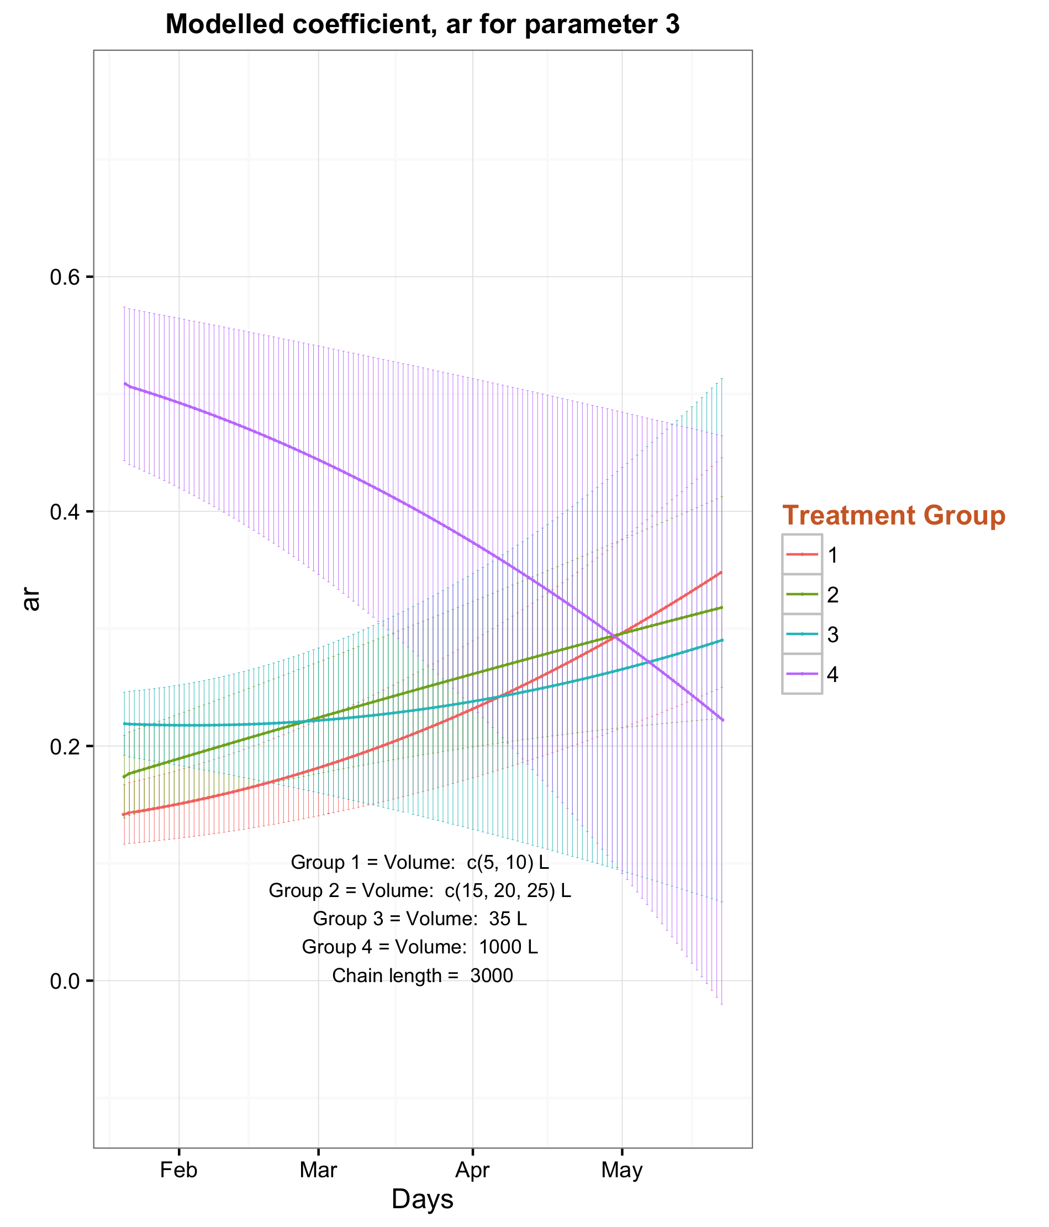
Findings
3 groups of treatments
4 groups of treatments
Notes:
Here are similar cluster of groups showing the root allocation fraction ar
All the sink limited treatments have low root allocation fraction except at the beginning of free seedling, which also goes down with time, possibly due to change of weather.
This result supports our hypothesis #3

Slide 29
Discussion
We suggest substantial modification to the existing DA framework which we believe becomes an invaluable tool for quantifying carbon fluxes in experimental systems
When and how much photosynthate is allocated to growth vs. storage
The storage pool is a significant portion of the total Carbon mass
Allow the assimilation of tissue-level measurements, such as measurements of leaf photosynthesis and dark respiration, which provide important constraints on the carbon budget
We prove the null hypothesis to be wrong as there are significant variations between the allocation fractions for different treatments over time
We establish the relationships between various allocation fractions and sink limitation
Notes:
We suggest substantial modification to the existing DA framework which we believe becomes an invaluable tool for quantifying carbon fluxes in experimental systems
Our modeling effort improves the understanding of photosynthate allocation to growth vs. storage
We model the storage pool from an experimental data and show that the storage pool is a significant portion of the total Carbon mass
We allow the assimilation of tissue-level measurements, such as measurements of leaf photosynthesis and dark respiration, which provide important constraints on the carbon budget.
We prove the null hypothesis to be wrong as there are significant variations between the allocation fractions for different treatments over time
We establish the relationships between various allocation fractions with sink limited treatments

Slide 30
Need your help!!
Any other hypothesis / interpretations of these outcomes?
Which grouping seems to be most reasonable in terms of the hypotheses?
To Court – Any particular suggestion for the treatment grouping?
Any other suggestions???
Alternative model selection??

Slide 31
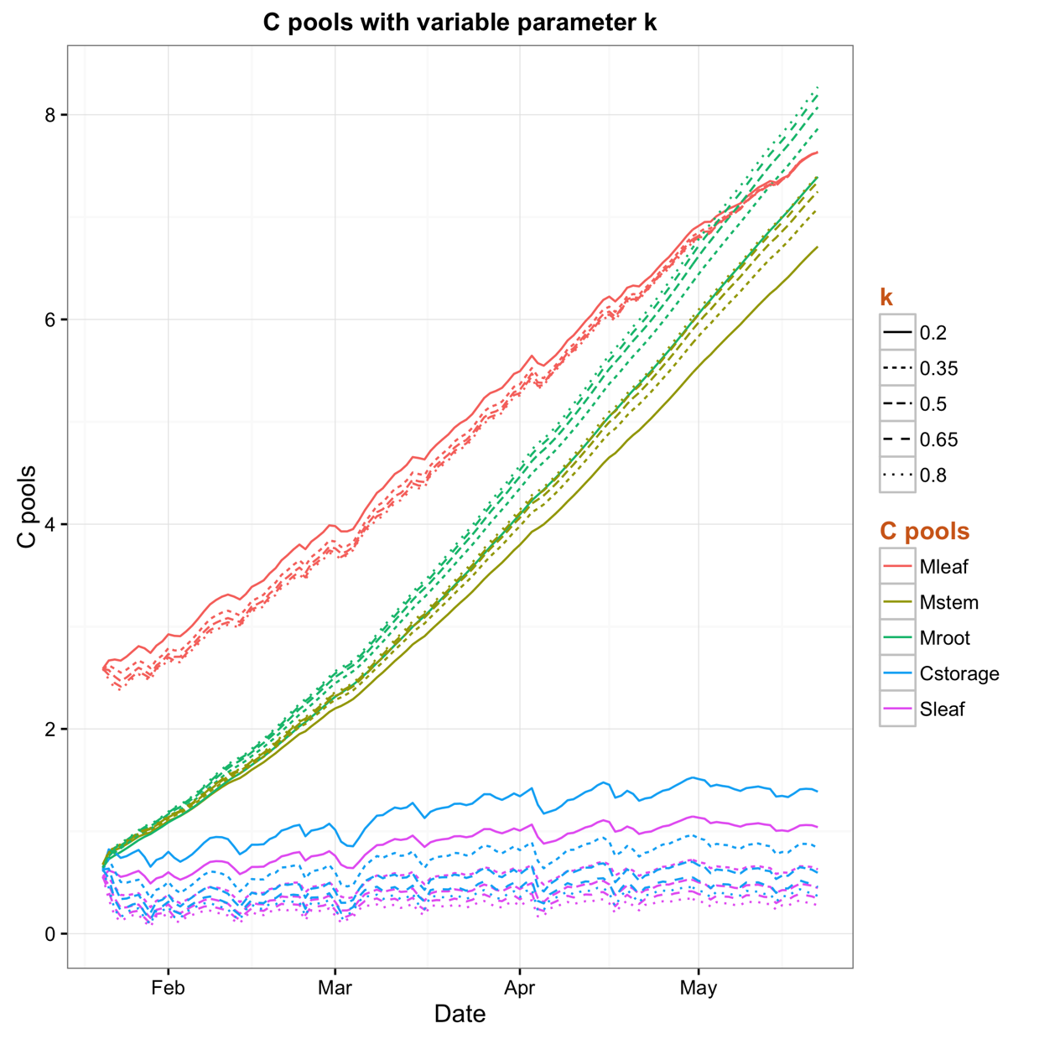
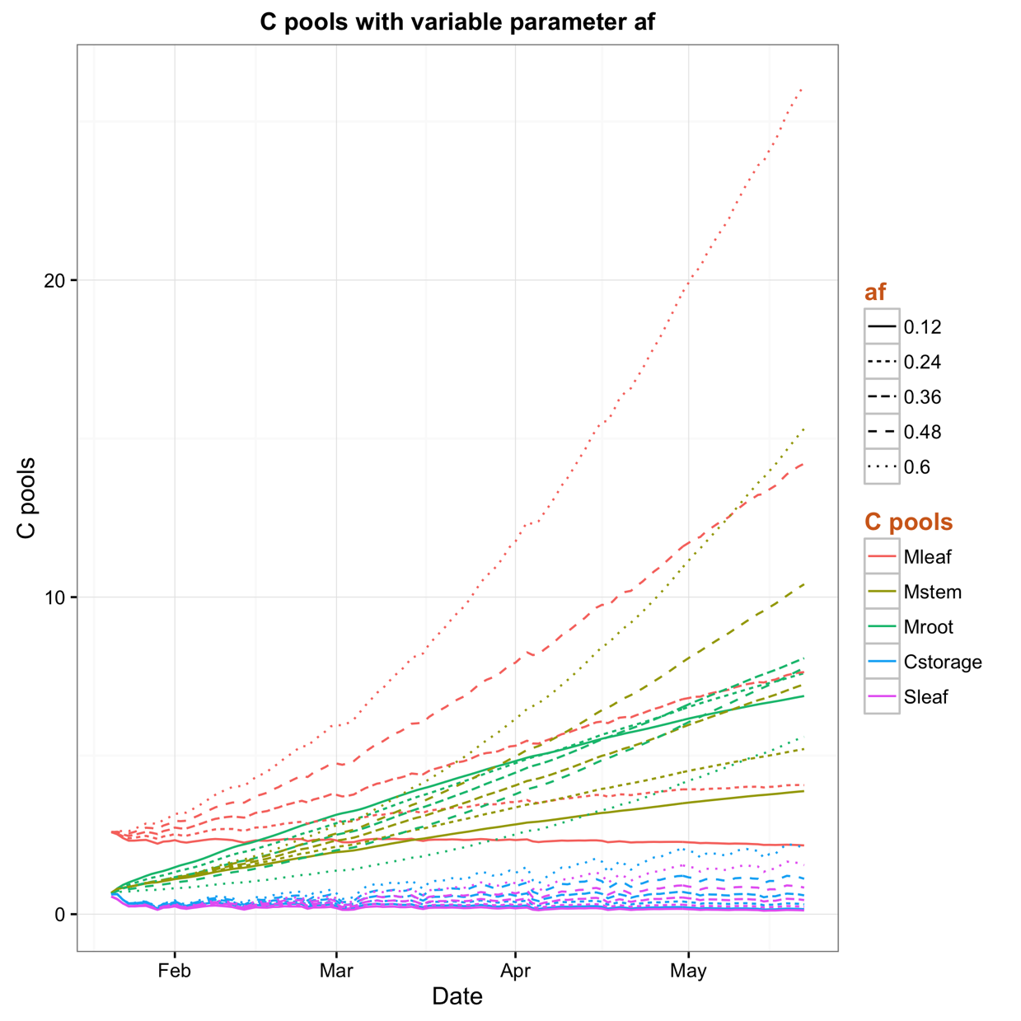
Parameter Sensitivity Test
The baseline parameters are: k = 0.5, Y = 0.3, af = 0.36, as = 0.3, sf = 0.005, ar = (1-af-as)
Notes:
The baseline parameters I’m using are: k=0.5, Y=0.3, af=0.36, as=0.3, sf=0.005, ar=(1-af-as).
These values are actually the median values of the range I consider for the sensitivity test.
When we look at the model equations for the C pools it seems quite obvious to have minimal effect of change of k on the C pools (Cleaf, Cstem, Croot).
The equations are:
Cleaf[i] <- Cleaf[i-1] + k*Cstorage[i-1]*af*(1-Y) - sf*Cleaf[i-1]
Cstem[i] <- Cstem[i-1] + k*Cstorage[i-1]*as*(1-Y)
Croot[i] <- Croot[i-1] + k*Cstorage[i-1]*(1-af-as)*(1-Y)
Now if we look at the storage pool, we can say that the storage pool is way bigger when we have low k value.
For example, storage goes up around 4 times with 4 times decrease of k.
Therefore, both k and Cstorage counteract each others' impact in these equations, which clearly demonstrate the reason behind minimal sensitivity of k when we compare various C pools, except the storage (that has obvious anti-proportional impact on k).

Slide 32
Alternative model setting
R_{a}
R_{growth}
Y
a_{f}
s_{f}
k
C_{f}
C_{lit}
GPP
C_{growth}
1-k
1-Y
a_{r}
C_{r}
C_{storage}
a_{s}
C_{s}
Notes:
Parameters are:
1. NSC/NPP is the fraction of annual NPP allocated to non-structural carbohydrate storage.
2. MinL/AGC is defined as a threshold minimum for the ratio of leaf carbon (LeafC) to above ground carbon and determines when NSC will be depleted to maintain AGC.
Tague et al, (2013) performed a sensitivity analysis which suggest values for the NSC/NPP parameter between 0.25 and 0.35 correctly predict the measurements with a MinL/AGC value of 0.05 (this number is based on field studies).

Slide 33
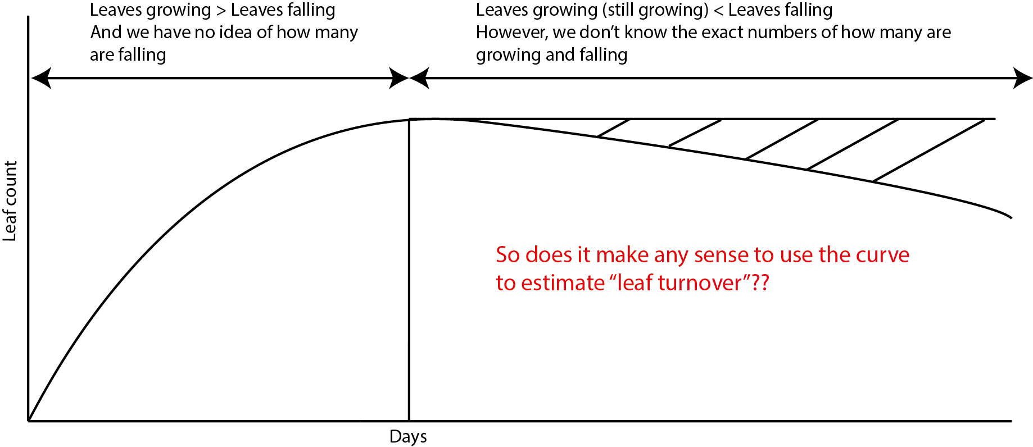
Estimate leaf turnover
Notes:
We were trying to estimate the leaf turnover to insert that in the model as an input
So this is the typical leaf count curve for the treatments and we were thinking to count the leaf turnover from the dashed area assuming that the leaf number becomes static, however which isn't the case in real field!!!
So does it make any sense to use this curve to estimate leaf turnover??

Slide 34
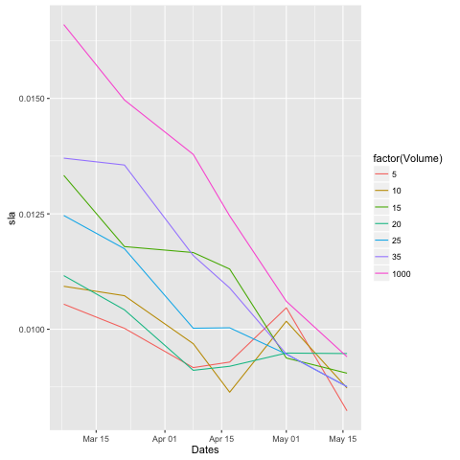
Change of SLA over time
Jan 21
Notes:
We were thinking about taking into account of SLA changes over time
And when we plot the data from march to may we got something like this, that shows clear evidence of SLA changes over time
However, we couldn’t figure out from where did these curves actually start from at the beginning of the experiment??
Do they start from the bottom or top or somewhere in the middle??

Slide 35
Alternative model setting
R_{a}
R_{growth}
Y
a_{f}
s_{f}
k
C_{f}
C_{lit}
GPP
C_{growth}
1-k
1-Y
a_{r}
C_{r}
m
C_{storage}
a_{s}
Storage depletion coefficient:
m > 0 if LeafC/AGC < minL/AGC = 0.05
C_{s}
Notes:
Parameters are:
1. NSC/NPP is the fraction of annual NPP allocated to non-structural carbohydrate storage.
2. MinL/AGC is defined as a threshold minimum for the ratio of leaf carbon (LeafC) to above ground carbon and determines when NSC will be depleted to maintain AGC.
Tague et al, (2013) performed a sensitivity analysis which suggest values for the NSC/NPP parameter between 0.25 and 0.35 correctly predict the measurements with a MinL/AGC value of 0.05 (this number is based on field studies).

